Slide 1
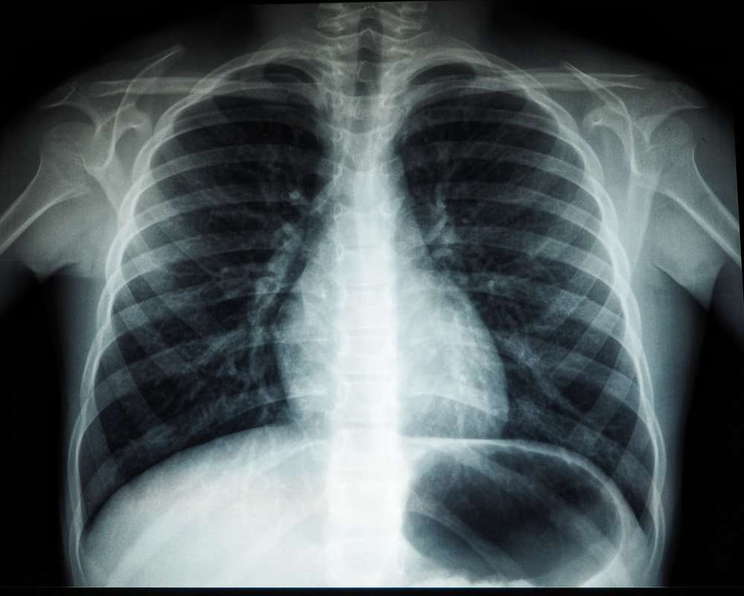
BY: Med-X (Team 1)
CS691
April 2024

Slide 2

AGENDA:
01
02
03
04
05
Recap:
Member Names
Roles and Responsibilities
Improvements
Project Description
Team Working Agreement
Personas
Project Overview:
MVP
Languages and Tools
Algorithms
Diagrams
Sprint 2 Recap
Backlogs:
Product Backlog
Sprint 3 Backlog
Test Cases
Story Completion
Team Metrics:
Team Velocity
Burndown Charts
Retrospective
Product:
Sprint 4 Stories
Application Screenshots
API
Live Application Demo

Slide 3



Team Roles and Responsibilities
Ronaldo Simbaña
Scrum Master | Developer
Marla Capistran
Team Leader | Database Admin
Filippo Zallocco
Developer

Slide 4


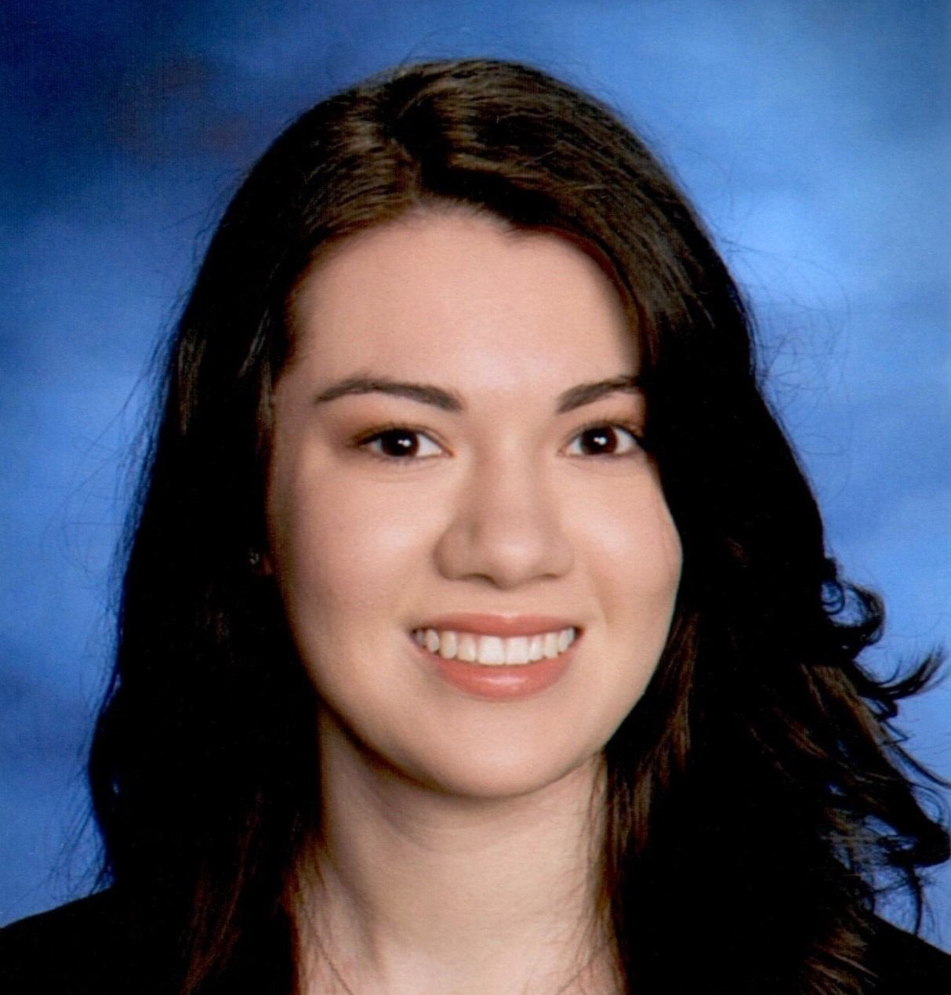
Team Roles and Responsibilities
Christopher Ospina
Developer
Anthony Muñoz
Quality Assurance / Tester Developer
Leanna Machado
Developer

Slide 5


Team Roles and Responsibilities
Rahul Nayanegali
Developer
Prithvi Raimangya
Designer | Developer

Slide 6
Improvements
Product Backlog placement (slides 39 - 42)
User Stories as Product Backlog (slide 39-42)
Change User ID to User Story ID (slides 39-58, 68-70)
Include a Test Case ID (slides 54-57)
Indicate Pass and Fail ratio of Test Cases (slides 57)
Burndown Charts use story points instead of hours (slides 60,61)
Dot Voting during the Retrospective
Star indicates an improvement made

Slide 7
Problem Statement
Currently, x-ray machines are widely available; however, clinical chest x-ray images can be challenging to read and diagnose. Furthermore, x-rays are not a priority for radiologists, as they tend to focus more on CT images and MRIs. CT scans are both harmful and expensive, in addition to being time consuming.

Slide 8
Project Description
A web app that has a highly trained deep learning model that classifies x-ray images, reducing the need for a radiologist to examine them
Intended for medical professionals and patients who upload x-ray chest images
Uses a deep-neural network models that will detect common health issues
Our application will reduce the time it takes for a patient to receive their diagnosis using AI
Notes:
We could mention that x-rays are comparatively less hazardous, less expensive, and less time-consuming than CT scan images.

Slide 9
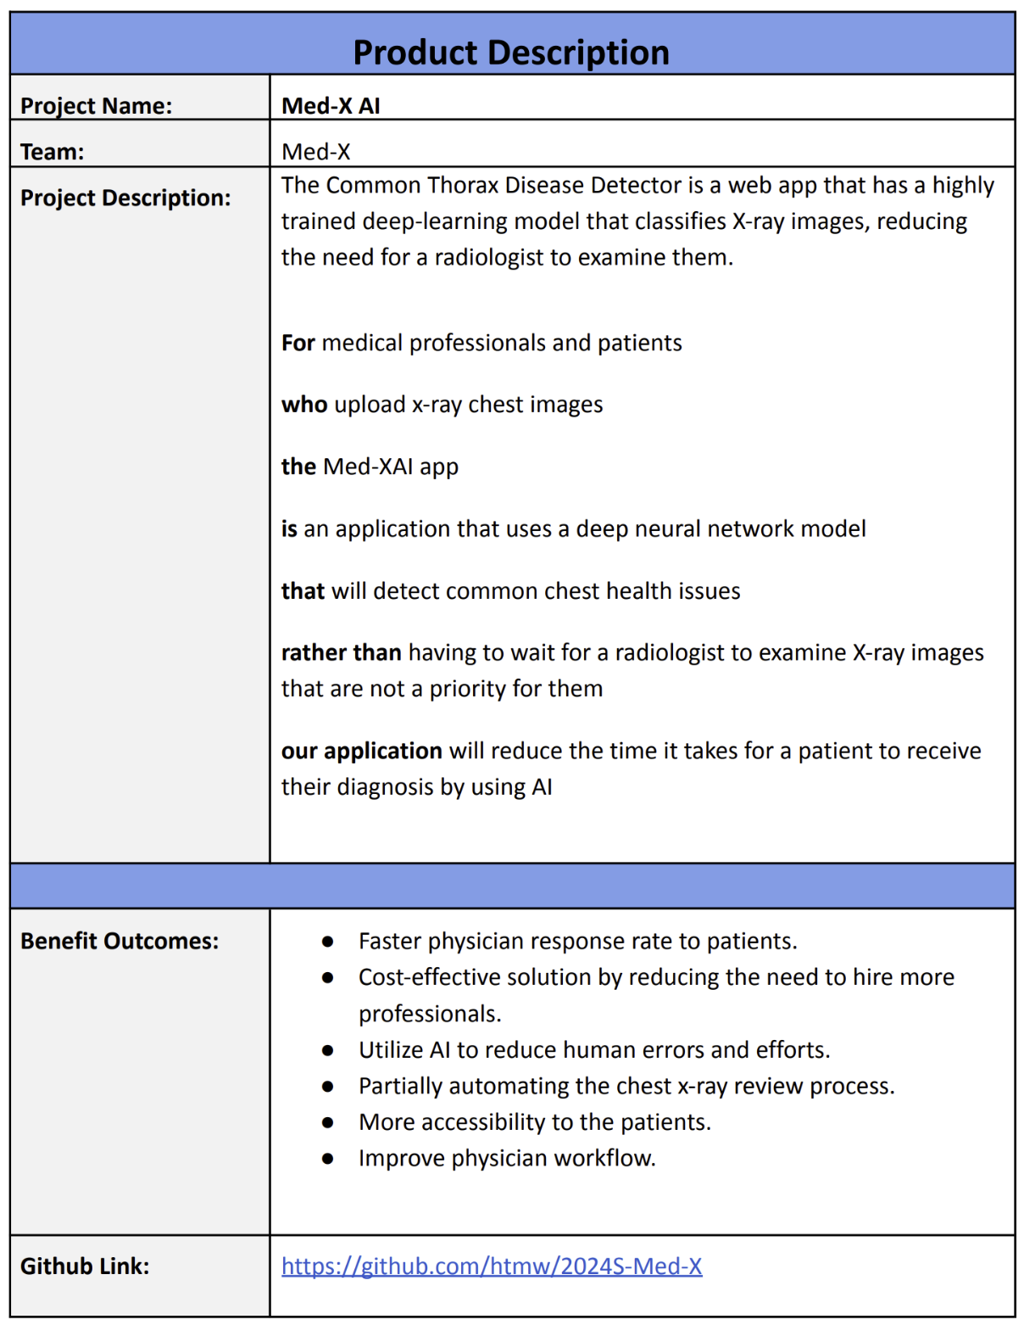
Project Description

Slide 10
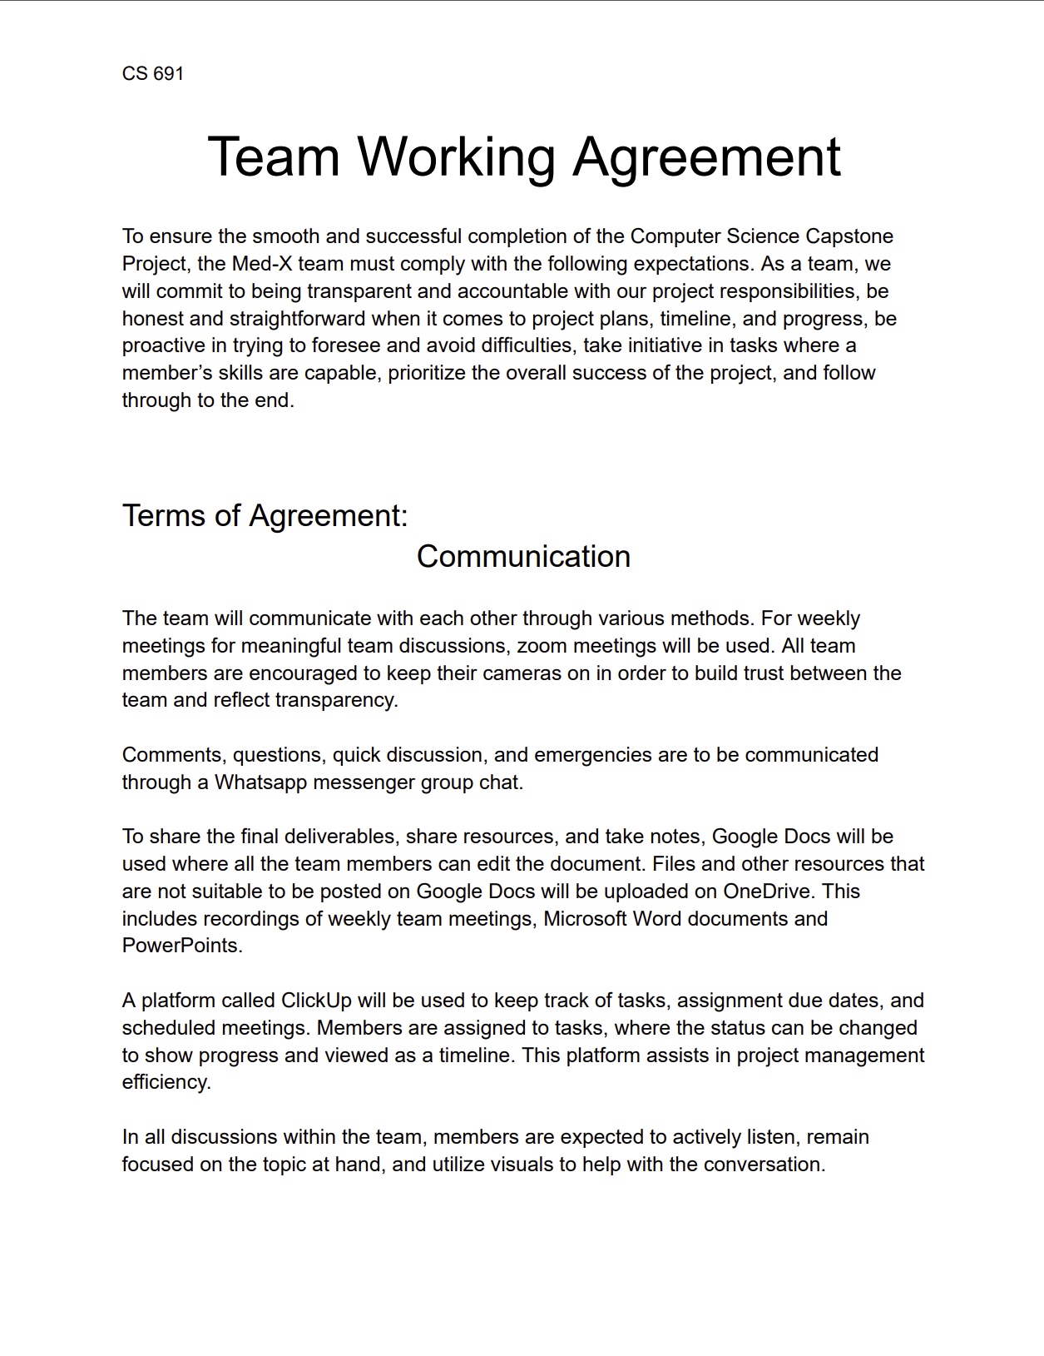
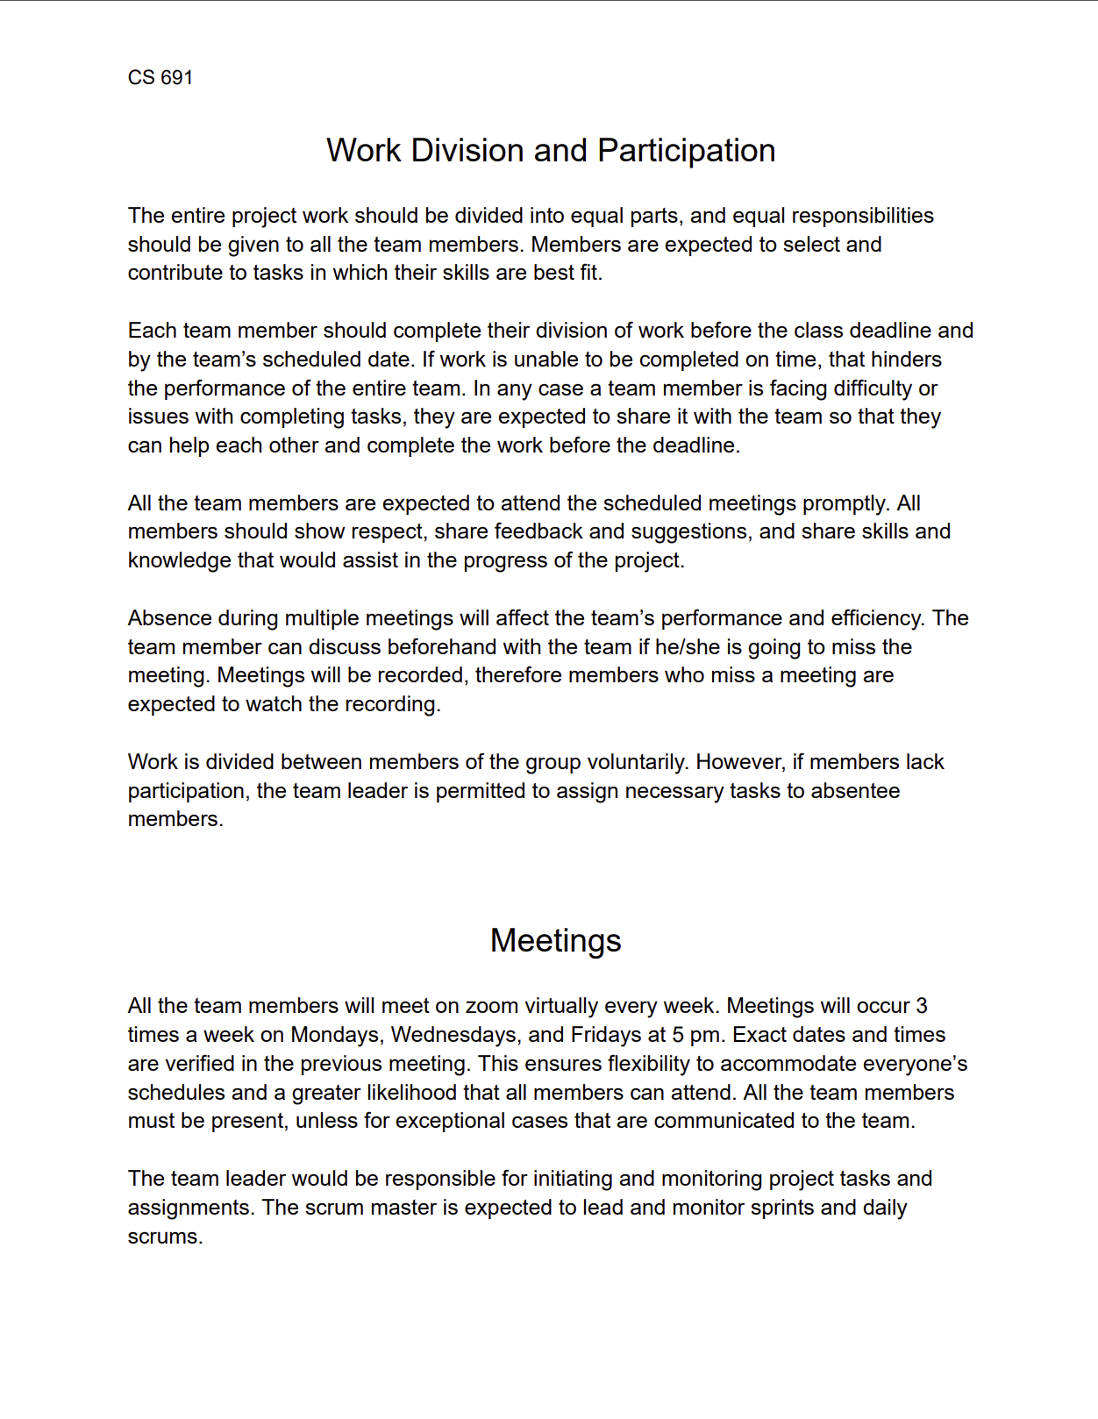
Team Working Agreement

Slide 11
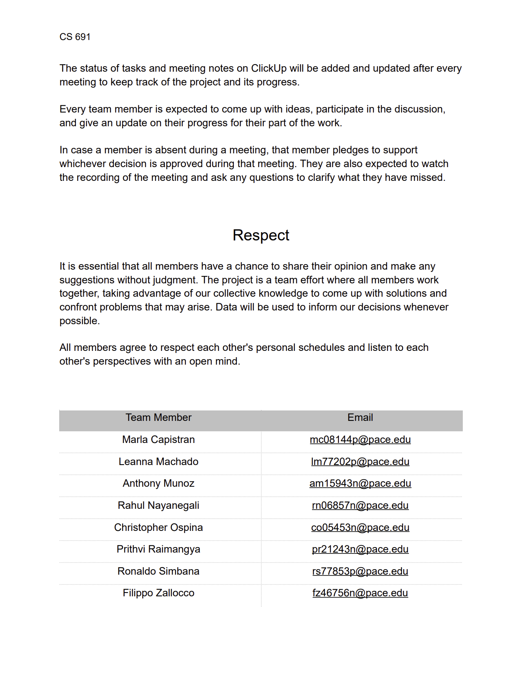
Team Working Agreement

Slide 12

Patient Persona
Harold Castillo
Age: 55
Gender: Male
Occupation: Restaurant Owner
Location: Red Bank, NJ
Harold gets regular check-ups for a man his age but has trouble scheduling due to his job. It’d be great if he could just view his results and get an idea of what they mean and potential next steps without having to keep going in person.
Goals
View reports/results online
Able to connect with doctor about results online
Simple site for ease of use
Challenges
Making it to follow-ups for results
Understanding the results, even after a consultation
Time taken to receive results

Slide 13

Radiologist Persona
Sandro Cuccigno
Age: 50
Gender: Male
Occupation: Radiologist
Location: Manhattan, NY
Hospital: NYU Langone Medical Center
Has been in the practice for 20 years. His team is understaffed and under equipped. Is often exhausted from reviewing x-rays and informing people they have a serious illness.
Goals
Process chest images fast
Help hospital tend to patients
Improve workflow for his team
Challenges
Increasing patient volumes
Burnout from long shift and nature of the job
Facility cutting funds
Spends many hours reviewing x-rays

Slide 14

Doctor Persona
Dr. Bryce Ruiz
Age: 34
Gender: Male
Occupation: Doctor
Location: Fresno, Ca
Hospital: Albuquerque Medical Center
A 34-year-old medical professional from Fresno. Has been working at Albuquerque for over 10 years and has recently been promoted to Cardiology to conduct x-rays
Goals
Build a strong reputation with patients
Explain to patients what they have in a clear manner
Challenges
Large volume of patients
Limited time for consultations
Patients are often confused about their diagnosis

Slide 15
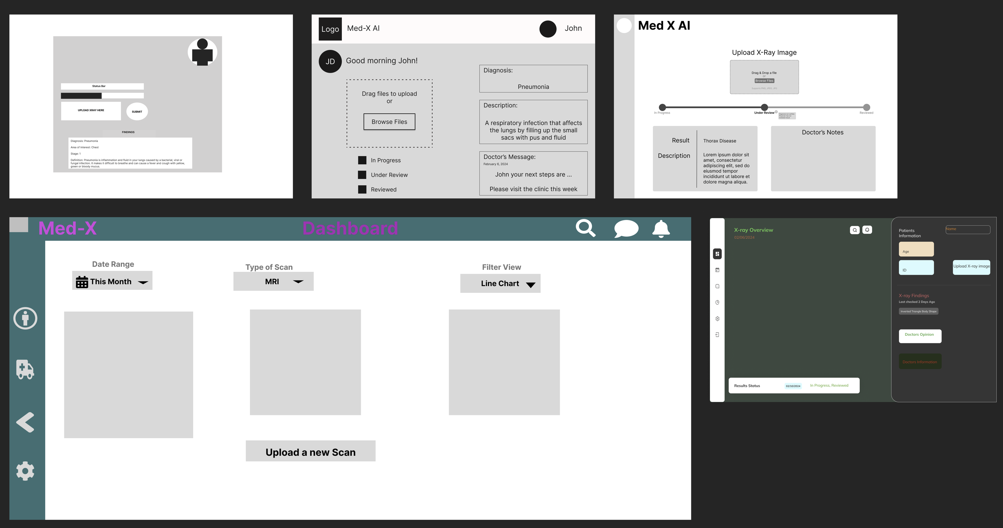
Product Discovery

Slide 16
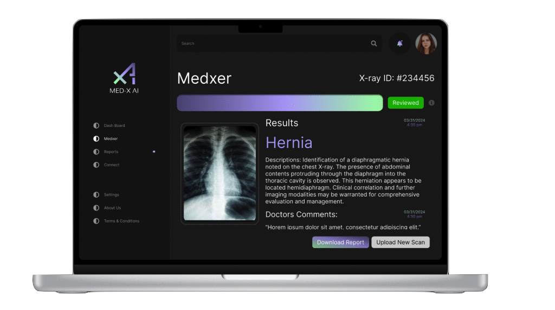
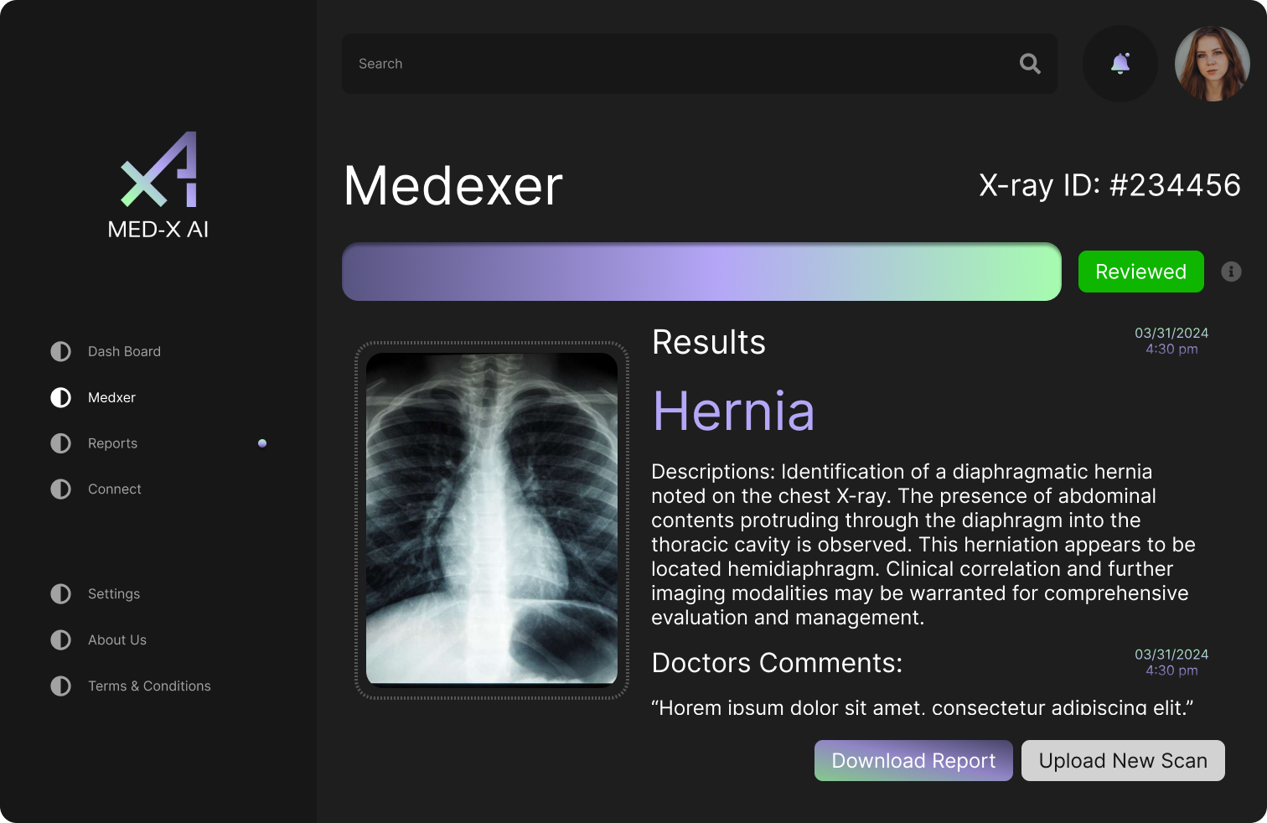
Final Product Design

Slide 17
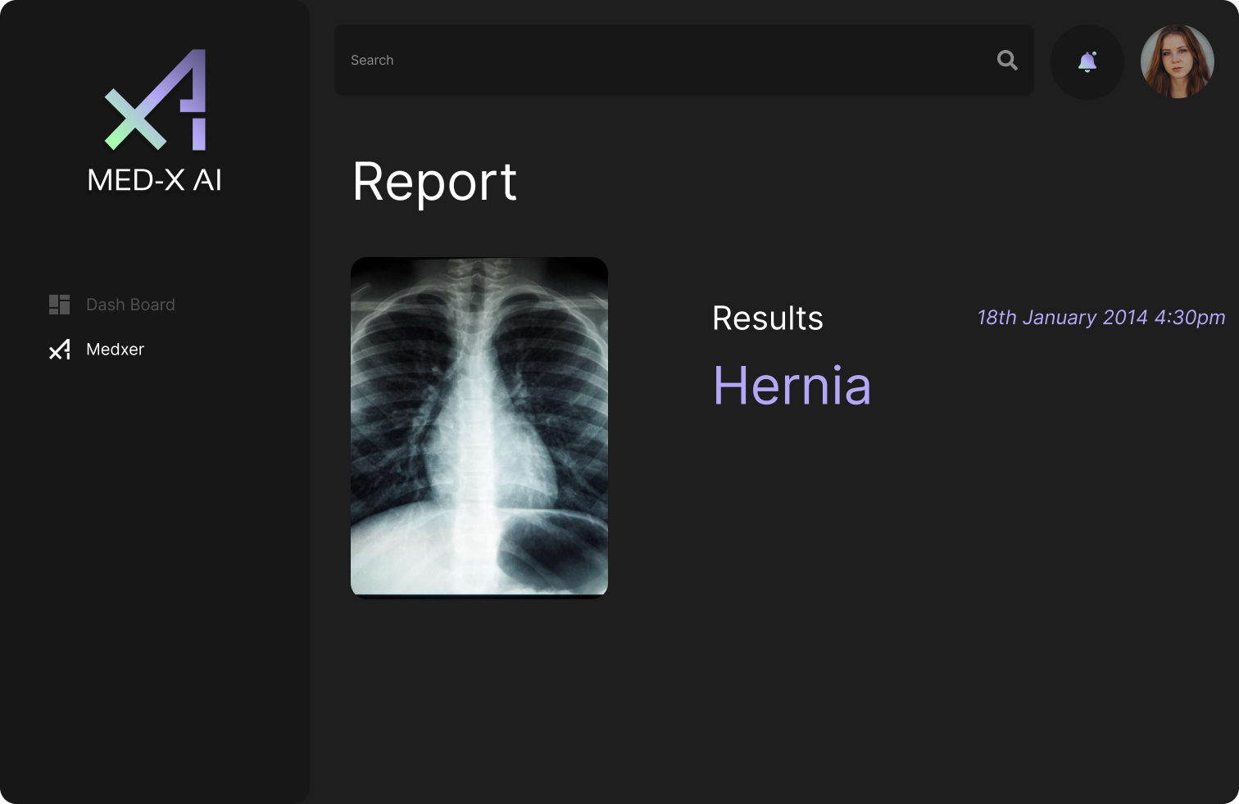
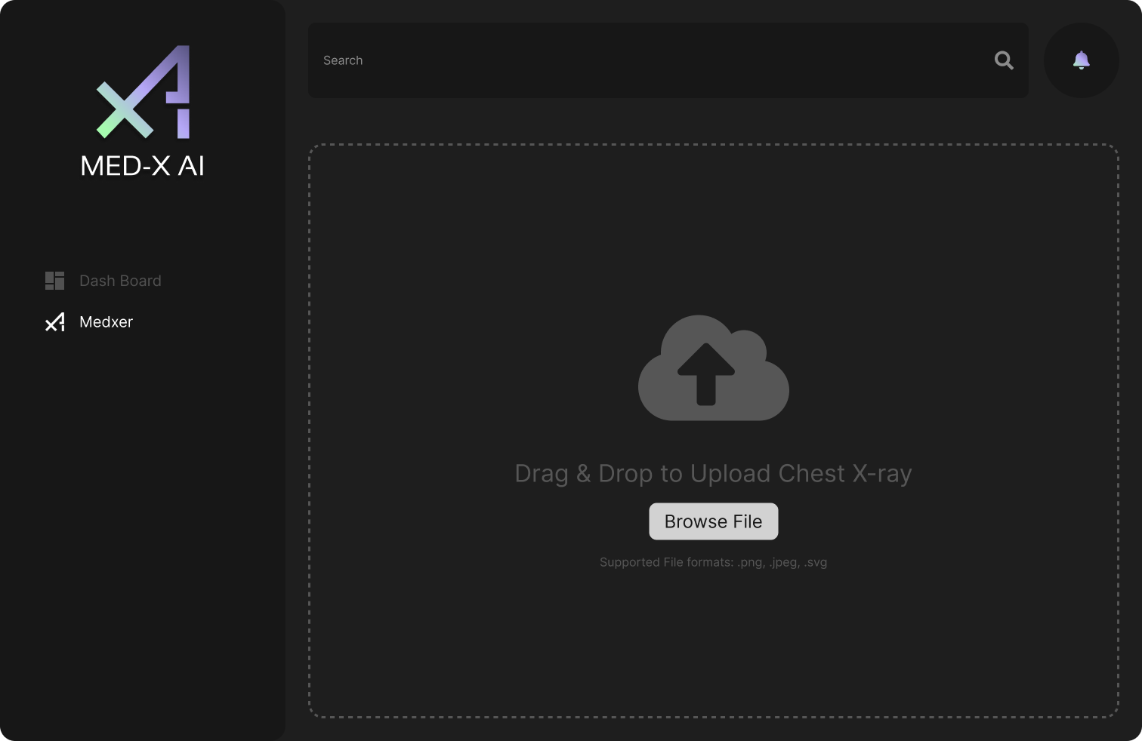
MVP Design

Slide 18

















Technologies & Algorithms
Programming Languages
and Frameworks
Algorithms
Database
Tools
Firebase
Figma
VSCode
HTML5
CSS
JavaScript
TensorFlow
CNN
Docker
GitHub
React
NodeJS
Flask
Keras
Python
Tailwind CSS
Insomnia

Slide 19
Technologies Explanation
HTML5
CSS
JavaScript
Flask
Python
Firebase
React
NodeJS
Tailwind CSS
MedX app leverages HTML, CSS, JavaScript, React, Node and Tailwind CSS for the dynamic user interface
Python's micro framework Flask is used to render the chest x-ray findings on the user interface by calling the trained model
Firebase is used to store the uploaded image and provides an endpoint URL to call the API

Slide 20
Technologies Explanation
Figma
VSCode
Insomnia
Docker
GitHub
Figma, VSCode, and GitHub are tools used for efficient collaboration. Figma enables a seamless contribution for the overall development. VSCode is the chosen code editor. GitHub allows remote version control and collaborative development. Docker simplifies deployment across all platforms. Insomnia is a tool used to test the APIs.

Slide 21
Algorithms Explanation
TensorFlow's Keras API is used for building and training our Convolutional Neural Network, which classifies x-ray images for diagnosis. The deep learning model integrates different layers.
Convolutional Layers
Batch Normalization
Dropout
Regularization
We optimized training with the Adam algorithm
TensorFlow
Keras
CNN

Slide 22
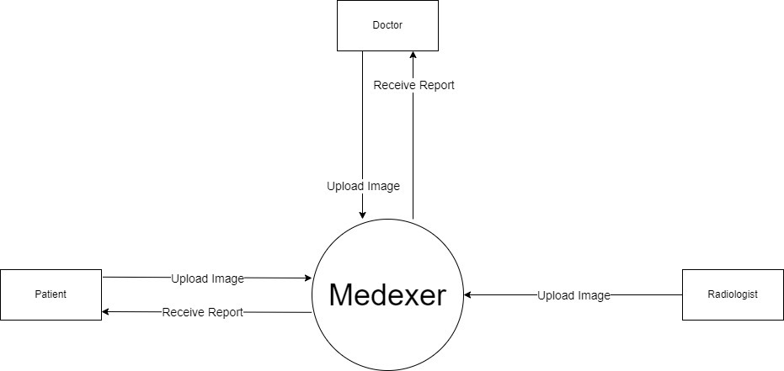
Context Diagram

Slide 23
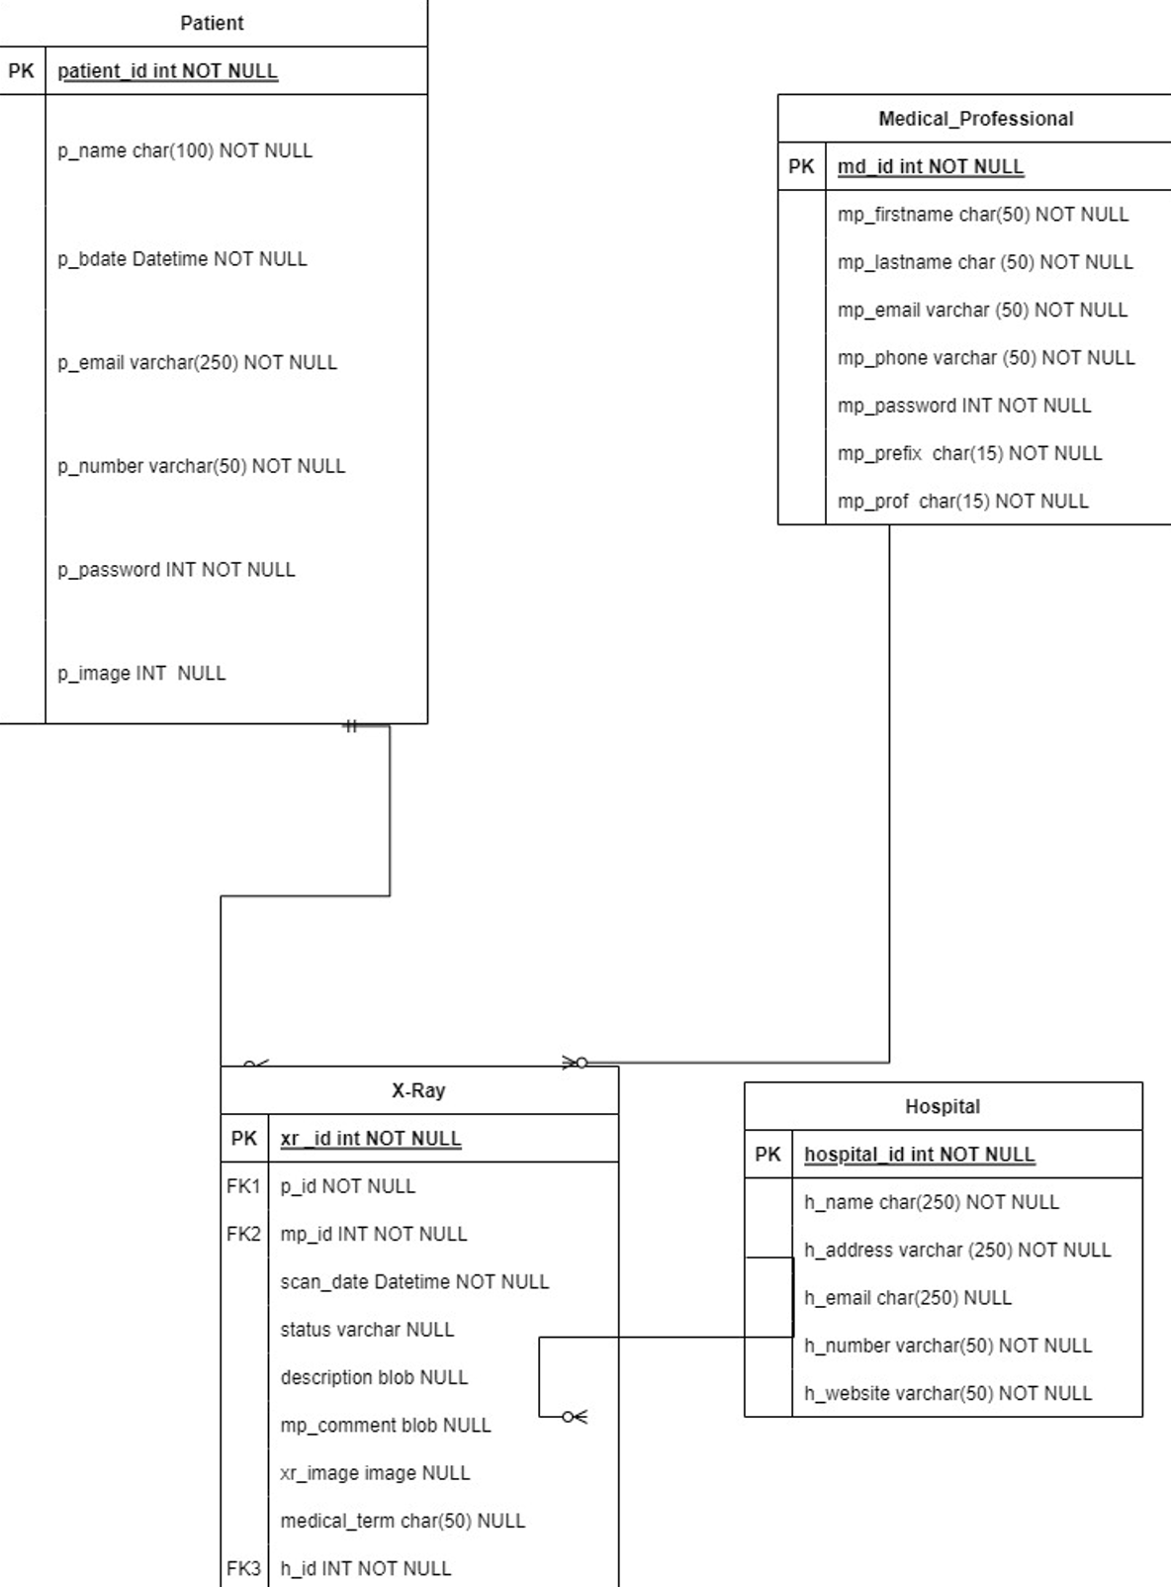
Class Diagram

Slide 24
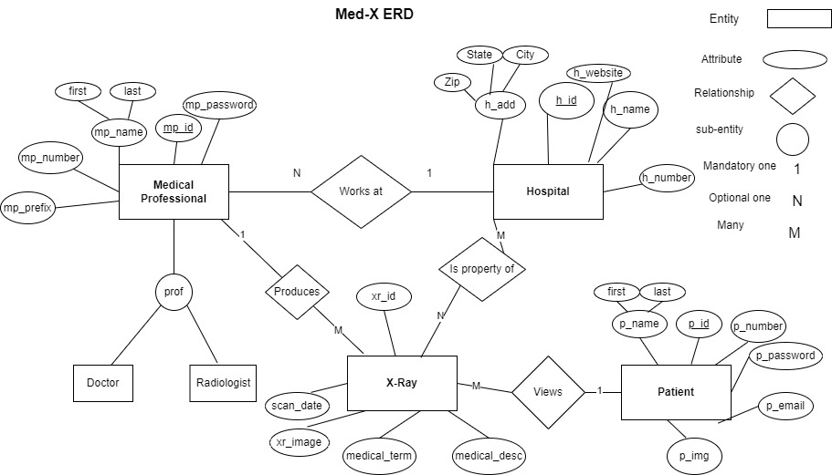
ER Diagram

Slide 25
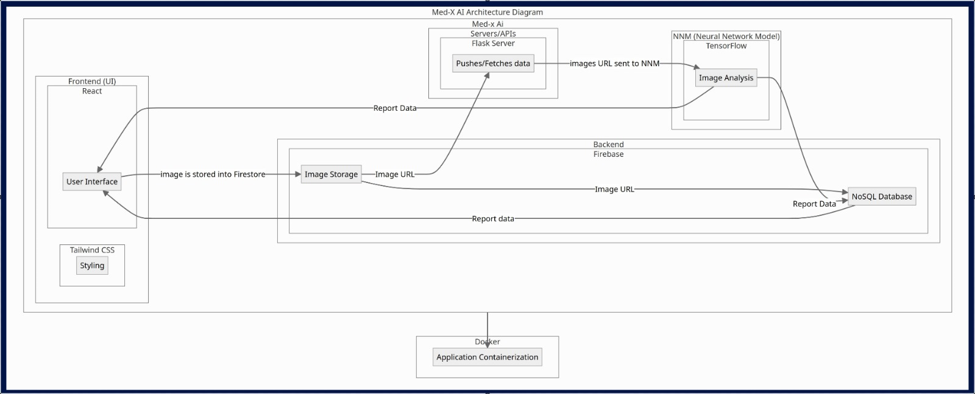
Architecture Diagram

Slide 26
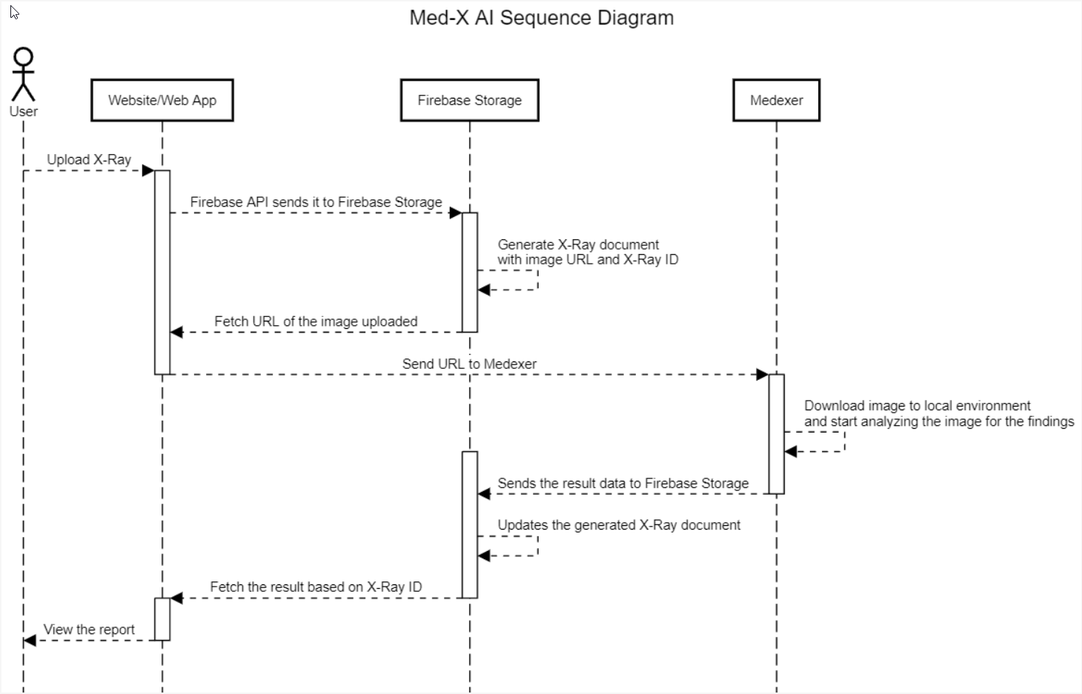
Sequence Diagram

Slide 27
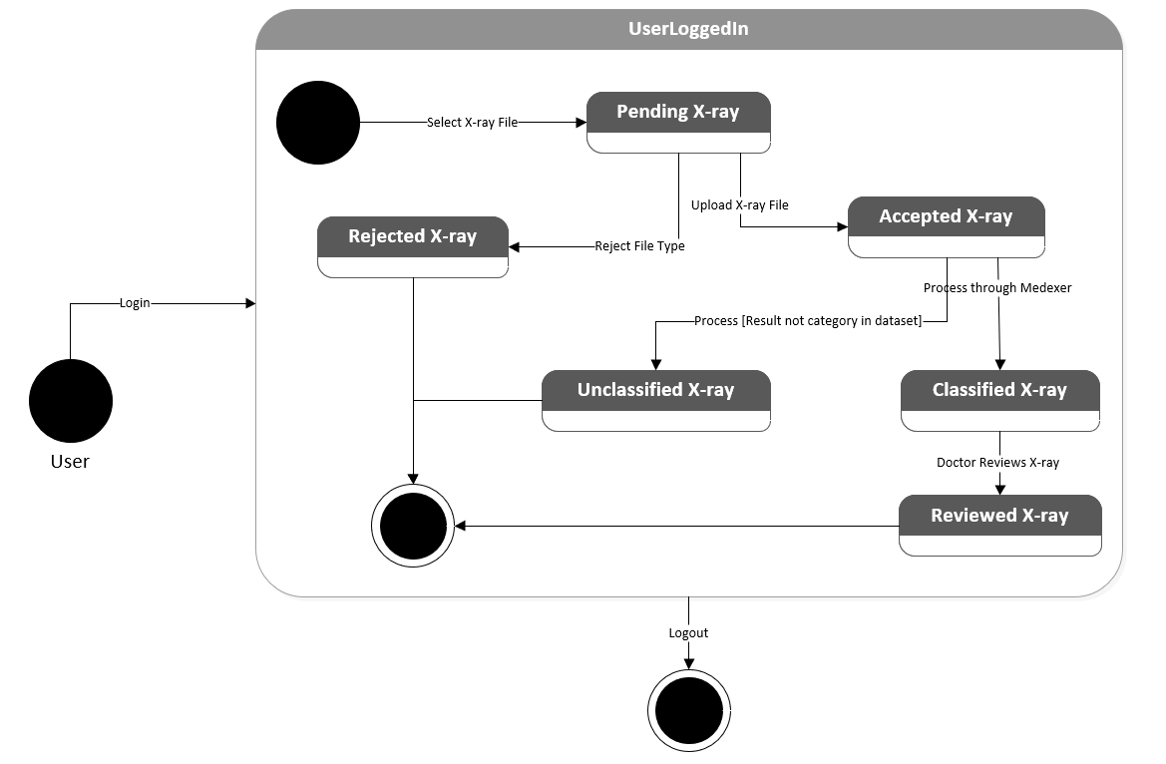
State Diagram

Slide 28
Sprint 2 Recap
Designed the UI for the Search bar
Image Upload and Submission to Firebase
Medical Term Result
Loading Page
Created Database Tables
Alert message after submitting x-ray image
Self-developed Neural Network Model
35 Story Points
Completed 100% of the Story Points

Slide 29
Product Backlog
Estimation | User Story ID | As a | I want | So that | Feature
3 | 1 | Radiologist | to easily upload x-ray images | doctors and patients have access to the images | Image Upload
3 | 2 | Doctor | to easily upload x-ray images | doctors and patients have access to the images | Image Upload
3 | 3 | Patient | to easily upload x-ray images from my personal machine | doctors have access to the images for review | Image Upload
13 | 4 | Radiologist | to provide quick and automated x-ray results for common chest health issues | more time can be dedicated to analyze uncommon chest health issues | Medexer (AI)
13 | 5 | Doctor | to provide quick and automated x-ray results for common chest health issues | patient response rate and physician workflow improves | Medexer (AI)
8 | 6 | Doctor | to add comments to patient x-ray results | patients are informed early about other information the result does not provide | Doctor Notes
5 | 7 | Patient | to view whether a doctor has reviewed my x-ray results | I can be more confident about the verified results | Reviewed Status
Legend:
Sprint 2
Sprint 3
Sprint 4

Slide 30
Product Backlog
Estimation | User Story ID | As a | I want | So that | Feature
2 | 8 | Patient | my x-ray results to be explained in simpler terms | I can better understand my diagnosis and health issue | Result Description
1 | 9 | Doctor | to download patient x-ray reports | I can store patient records locally | Download Report
1 | 10 | Patient | to download my x-ray reports | I can store patient records locally | Download Report
5 | 11 | Patient | to have access to all of my x-ray report history | I can track my chest health issues | Report History
5 | 12 | Doctor | to have access to all patient x-ray report histories | I can track patient chest health issues | Report History
2 | 13 | Patient | to quickly view my latest x-ray report | my most recent information is easily accessible | Dashboard
5 | 14 | Patient | to be notified once there is a change to my reports (upload, review, notes, etc.) | I can be informed about any updates as soon as possible | Notification
Legend:
Sprint 2
Sprint 3
Sprint 4

Slide 31
Product Backlog
Estimation | User Story ID | As a | I want | So that | Feature
5 | 15 | Doctor | to be notified once there is a change to patient reports (upload, report, etc.) | I can be informed about any updates as soon as possible | Notification
8 | 16 | Doctor | to browse a specific report and record | I can quickly locate specified information | Search
8 | 17 | Patient | to browse a specific report and record | I can quickly locate specified information | Search
3 | 18 | Radiologist | to register and store my personal info (ID, name, D.O.B.) in my own account | I can access patient information and connect with patients and doctors privately | Profile
3 | 19 | Doctor | to register and store my personal info (ID, name, D.O.B.) in my own account | I can access patient information and connect with patient and radiologists privately | Profile
Legend:
Sprint 2
Sprint 3
Sprint 4

Slide 32
Product Backlog
Estimation | User Story ID | As a | I want | So that | Feature
3 | 20 | Patient | to register and store my personal info (ID, name, D.O.B.) in my own account | I can access my medical information and connect with doctors privately | Profile
3 | 21 | Patient | to login and logout of my own account | my medical information, records and reports are secure | Login/Logout
3 | 22 | Doctor | to login and logout of my own account | Patient medical information, records and reports are secure | Login/Logout
3 | 23 | Patient | to login using my e-mail address | I can access my medical information, records and reports | Login/Logout
3 | 24 | Doctor | to login using my medical professional ID number | I can access patient medical information, records and reports | Login/Logout
1 | 25 | Patient | update my personal information such as my name, address, phone number etc. | the portal has up-to-date information in the event I need to be reached urgently | Profile
Legend:
Sprint 2
Sprint 3
Sprint 4

Slide 33
User Stories
User Story ID | Scenario | Summary | Criteria | Feature
1 | As a Radiologist I want to easily upload x-ray images so that doctors and patients have access to the images
 | A radiologist wants to upload an x-ray image | Given I'm a radiologist when I open the Med-X AI web app I should be able to locate an upload button that when clicked on and an image is selected then the application will store the image for processing | Med-X AI App will store the image for processing | Image Upload
2 | As a Doctor I want to easily upload x-ray images so that doctors and patients have access to the images
 | A doctor wants to upload an x-ray image | Given I'm a doctor when I open the Med-X AI web app I should be able to locate an upload button that when clicked on and an image is selected then the application will store the image for processing | Med-X AI App will store the image for processing | Image Upload
3 | As a Patient I want to easily upload x-ray images from my personal machine so that doctors have access to the images for review
 | A patient wants to upload an x-ray image | Given I'm a patient when I open the Med-X AI web app I should be able to locate an upload button that when clicked on and an image is selected then the application will store the image for processing | Med-X AI App will store the image for processing | Image Upload
Legend:
Sprint 2
Sprint 3
Sprint 4

Slide 34
User Stories
User Story ID | Scenario | Summary | Criteria | Feature
4 | As a Radiologist I want to provide quick and automated x-ray results for common chest health issues so that more time can be dedicated to analyze uncommon chest health issues
 | A radiologist wants to quickly provide an x-ray result | Given I'm a radiologist when I upload an x-ray image then the application will provide a quick diagnosis | Med-X AI App will provide a diagnosis (finding) for the chest health issue | Medexer (AI)
5 | As a Doctor I want provide quick and automated x-ray results for common chest health issues so that patient response rate and physician workflow improves
 | A doctor wants to quickly access patient x-ray results | Given I'm a doctor when an x-ray image produces quick results I can then access the result in order to provide patients with a verified response | Med-X AI App will provide a diagnosis (finding) for the chest health issue | Medexer (AI)
6 | As a Doctor I want to add comments to patient results so that patients are informed early about other information the result does not provide
 | A doctor wants to write a comment to patient about the x-ray result | Given I'm a doctor when I click on the Doctor's Comments section on a patient's report I can then type and post a message that the patient can see | Med-X AI App will provide a text message section for each report to allow doctors to post | Doctor Notes
Legend:
Sprint 2
Sprint 3
Sprint 4

Slide 35
User Stories
User Story ID | Scenario | Summary | Criteria | Feature
7 | As a Patient I want to view whether a doctor has reviewed my x-ray results so that I can be more confident about the verified results
 | A patient wants to see any additional comments from the doctor | Given I'm a patient when I click on a report in Reports, I can then view a status bar reporting if a doctor has verified the x-ray result | Med-X App will allow patients to view "Under Review" or "Reviewed" status bar in reports | Reviewed Status
8 | As a Patient I want my x-ray results to be explained in simpler terms so that I can better understand my diagnosis and health
 | A patient wants to better understand their x-ray result | Given I'm a patient when I click on a report in Reports tab, I can then view a text description of the result in plain language so I can better understand the technical result | Med-X AI App will provide a text description of the finding in the selected report | Result Description
9 | As a Doctor I want to download patient x-ray reports so that I can store patient records locally
 | A Doctor wants to store patient records locally | Given I'm a doctor when I open a patient's report and click a download button the selected record is then downloaded and saved to my local computer | Med-X AI App will transfer the report file from the remote system to the user's local system | Download Report
Legend:
Sprint 2
Sprint 3
Sprint 4

Slide 36
User Stories
User Story ID | Scenario | Summary | Criteria | Feature
10 | As a Patient I want to download my x-ray reports so that I can store my records locally
 | A patient wants to store medical records locally | Given I'm a patient when I open my report and click a download button the selected report is then downloaded and saved to my local computer | Med-X AI App will transfer the report file from the remote system to the user's local system | Download Report
11 | As a Patient I want to have access to my x-ray report history so that I can track my chest health issues
 | A patient wants to keep track of all of their x-ray reports | Given I'm a patient when I click on the Reports tab then I should see a gallery of reports that have been generated | Med-X AI App will store all the reports in the cloud | Report History
12 | As a Doctor I want to have access to patient x-ray report histories so that I can track patient chest health issues
 | A doctor wants to keep track of their patients reports | Given I'm a doctor when I click on the Reports tab of a specific patient then I should see a gallery of reports that has been generated for that patient | Med-X AI App will store all the reports in the cloud | Report History
Legend:
Sprint 2
Sprint 3
Sprint 4

Slide 37
User Stories
User Story ID | Scenario | Summary | Criteria | Feature
13 | As a Patient I want to quickly view my latest x-ray report so that my most recent information is easily accessible
 | A patient wants to view their latest x-ray report | Given I'm a patient when I log into the account then the Dashboard page will be displayed with the most recent x-ray results | Med-X AI App will open to the Dashboard upon sign in | Dashboard
14 | As a Patient I want to be notified once there is a change to my reports (upload, review, notes, etc.) so that I can be informed about any updates as soon as possible
 | A patients wants to be informed of any changes to their reports | Given I'm a patient when a change is made to my report then I should receive a notification | Med-X AI App will alert the user of a change made to their report | Notification
15 | As a Doctor I want to be notified once there is a change to patient reports (upload, report, etc.) so that I can be informed about any updates as soon as possible
 | A doctor wants to be informed of any changes to patient reports | Given I'm a doctor when a change is made to a patient report then I should receive a notification | Med-X AI App will alert the user of a change made to their report | Notification
Legend:
Sprint 2
Sprint 3
Sprint 4

Slide 38
User Stories
User Story ID | Scenario | Summary | Criteria | Feature
16 | As a Doctor I want to browse all reports and records so that I can quickly locate specified information
 | A doctor wants to locate a specific report/record | Given I'm a doctor when I search for a report in the search bar then I should be able to quickly locate it | Med-X AI App will store reports using an x-ray id and patient name | Search
17 | As a Patient I want to browse my reports and records so that I can quickly locate specified information
 | A patient wants to locate a specific report/record | Given I'm a patient when I search for a report in the search bar then I should be able to quickly locate it | Med-X AI App will store reports using an x-ray id | Search
18 | As a Radiologist I want to register and store my personal info (ID, name, DOB) in my own account so that I can access patient information and connect to patients and doctors privately
 | A radiologist wants to create their own account to securely access patient information | Given I'm a radiologist when I use the app, I should be able to have my own account then patient information will be secured, and communication will be private | Med-X AI App will store user credentials (medx ID) | Profile
Legend:
Sprint 2
Sprint 3
Sprint 4

Slide 39
User Stories
User Story ID | Scenario | Summary | Criteria | Feature
19 | As a Doctor I want to register and store my personal info (ID, name, DOB) in my own account so that I can access patient information and connect to patients and radiologists privately
 | A doctor wants to create their own account to securely access patient information | Given I'm a doctor when I use the app, I should be able to have my own account then patient information will be secured, and communication will be private | Med-X AI App will store user credentials (medx ID) | Profile
20 | As a Patient I want to register and store my personal info (ID, name, DOB) in my own account so that I can access my medical information and connect to doctors privately
 | A patient wants to create their own account to securely access their information | Given I'm a patient when I use the app, I should be able to have my own account then my information will be secured, and communication will be private | Med-X AI App will store email and password | Profile
Legend:
Sprint 2
Sprint 3
Sprint 4

Slide 40
User Stories
User Story ID | Scenario | Summary | Criteria | Feature
21 | As a Patient I want to login and logout of my own account so that my medical information, records and reports are secure
 | A patient wants to securely and privately start and end sessions on their account | Given I'm a patient when I open the app, I then am prompted to log in to my account with my credentials and click a logout button to end my session | Med-X AI App will begin with a login page and have a button to logout of the current account | Login/Logout
22 | As a Doctor I want to login and logout of my own account so that patient medical information, records and reports are secure
 | A doctor wants to securely and privately start and end sessions on their account | Given I'm a doctor when I open the app, I then am prompted to log in to my account with my credentials and click a logout button to end my session | Med-X AI App will begin with a login page and have a button to logout of the current account | Login/Logout
Legend:
Sprint 2
Sprint 3
Sprint 4

Slide 41
User Stories
User Story ID | Scenario | Summary | Criteria | Feature
23 | As a Patient I want to login using my e-mail address so that I can access my medical information, records and reports
 | A patient wants to access their medical records by using their personal e-mail address | Given I'm a patient when I am prompted to login, I can then enter my personal e-mail address to access the records related to my account | Med-X AI App will create and store patient accounts through e-mail (username) | Login/Logout
24 | As a Doctor I want to login using my medical professional ID number so that I can access patient medical information, records and reports
 | A doctor wants to access patient medical records by using their ID number | Given I'm a doctor when I am prompted to login, I can then enter my personal medx ID number to access the records related to my account | Med-X AI App will create and store doctor accounts through their ID number (username) | Login/Logout
Legend:
Sprint 2
Sprint 3
Sprint 4

Slide 42
User Stories
User Story ID | Scenario | Summary | Criteria | Feature
25 | As a Patient I want to update my personal information such as my name, address, phone number, etc. so that the portal has up-to-date information in the event I need to be reached urgently
 | A patient wants to update personal profile information when they change | Given I'm a patient when I click my profile and the edit button, I can then change the inputted profile information (name, address, phone number, etc.) and click save | Med-X AI App will allow patients to update profile information and store the changes in the database | Profile
Legend:
Sprint 2
Sprint 3
Sprint 4

Slide 43
Sprint 3 Backlog:
Estimation | User Story ID | As a | I want | So that | Feature
8 | 6 | Doctor | to add comments to patient x-ray results | patients are informed early about other information the result does not provide | Doctor Notes
5 | 7 | Patient | to view whether a doctor has reviewed my x-ray results | I can be more confident about the verified results | Reviewed Status
1 | 9 | Doctor | to download patient x-ray reports | I can store patient records locally | Download Report
1 | 10 | Patient | to download my x-ray reports | I can store patient records locally | Download Report
2 | 13 | Patient | to quickly view my latest x-ray report | my most recent information is easily accessible | Dashboard
8 | 16 | Doctor | to browse a specific report and record | I can quickly locate specified information | Search
8 | 17 | Patient | to browse a specific report and record | I can quickly locate specified information | Search
Sprint 3 Story Points: 33

Slide 44
Test Cases
Test ID | User Story ID | Feature to Test | Test Case | Test Steps | Test Data | Expected Result | Actual Result | Pass/ Fail | Comments
7 | 16&17 | Search | Search by Report ID | Dashboard --> Click on Search Bar --> Type Exact Report ID | ID number - 00006 | Report ID is displayed | 00006 | Pass
8 | 16&17 | Search | Search by Report ID | Dashboard --> Click on Search Bar --> Type Partial Report ID | ID number - 0 | Report ID's containing the numbers are displayed as a list | 00000, 00001, 00002, 00003, 00004, 00005, 00006 | Pass
9 | 16&17 | Search | Search by invalid Report ID | Dashboard --> Click on Search Bar --> Type Invalid Report ID | ID number - 10111 | No Report ID is displayed | No Report ID is displayed | Pass
10 | 16&17 | Search | Search by Reviewed Status | Dashboard --> Click Search Bar --> Type Reviewed | X-ray Document | A list of Report ID's that are Reviewed | 00000, 00001 | Pass

Slide 45
Test Cases
Test ID | User Story ID | Feature to Test | Test Case | Test Steps | Test Data | Expected Result | Actual Result | Pass/ Fail | Comments
11 | 16&17 | Search | Search by Reviewed Status | Dashboard --> Click Search Bar --> Type Reviewing | X-ray Document | A list of Report ID's that are under Review | 00002, 00003, 00004, 00005, 00006 | Pass
12 | 16&17 | Search | Search by Date | Dashboard --> Click on Search Bar --> Type Date | Date – 3/29/2024 | All Report ID's with the specified date are displayed | 1 report - 00002, Lung Opacity, Reviewing, 3/29/2024 | Pass
13 | 13 | Dashboard | Dashboard for doctor | Click on Doctor --> Dashboard | X-ray Document | Dashboard for specified user is displayed | Dashboard for doctor | Pass
14 | 13 | Dashboard | Dashboard for patient | Click on Patient --> Dashboard | X-ray Document | Dashboard for specified user is displayed | Dashboard for patient | Pass

Slide 46
Test Cases
Test ID | User Story ID | Feature to Test | Test Case | Test Steps | Test Data | Expected Result | Actual Result | Pass/ Fail | Comments
15 | 9&10 | Download Report | Download existing pdf report | Dashboard --> Medexer tab --> Click Browse Button --> Select a PNG/JPG image --> Click Submit --> Click Print Report | X-ray Document | Download report pdf | Report is Downloaded to selected File Location | Pass
16 | 9&10 | Download Report | Printing existing pdf report | Dashboard --> Medexer tab --> Click Browse Button --> Select a PNG/JPG image --> Click Submit --> Click Print Report | X-ray Document | Prints report pdf | Printer prints the report | Pass
17 | 6 | Doctors Notes | Comment Added | Dashboard --> Report tab --> Click on the Comment Box | String comment | Adds comment to report | Doctor's note is added to report | Pass

Slide 47
Test Cases
Test ID | User Story ID | Feature to Test | Test Case | Test Steps | Test Data | Expected Result | Actual Result | Pass/ Fail | Comments
18 | 6 | Doctors Notes | Status Bar Reflecting Status Change | Dashboard --> Click on Report tab --> Select X-ray Report --> Update the Report by typing a comment --> Click on Update Report Button | String Comment | Status changes from "Reviewing" to Reviewed | Status changes from Reviewing to Reviewed | Fail | Can click on Update Report Button without a comment and still change the status to Reviewed
19 | 7 | Reviewed Status | Update Report | Dashboard --> Click on Report tab --> Select X-ray Report --> Check Report Status | X-ray Document | The status of the report is reviewed if a doctor has reviewed it otherwise it will say reviewing | Reviewing | Pass
Pass/ Fail Ratio: 12/13 = 92%

Slide 48
Sprint 3 Story Completion
Estimation | User Story ID | As a | I want | So that | Feature | Status
8 | 6 | Doctor | to add comments to patient x-ray results | patients are informed early about other information the result does not provide | Doctor Notes | Completed
5 | 7 | Patient | to view whether a doctor has reviewed my x-ray results | I can be more confident about the verified results | Reviewed Status | Completed
1 | 9 | Doctor | to download patient x-ray reports | I can store patient records locally | Download Report | Completed
1 | 10 | Patient | to download my x-ray reports | I can store patient records locally | Download Report | Completed
2 | 13 | Patient | to quickly view my latest x-ray report | my most recent information is easily accessible | Dashboard | Completed
8 | 16 | Doctor | to browse a specific report and record | I can quickly locate specified information | Search | Completed
8 | 17 | Patient | to browse a specific report and record | I can quickly locate specified information | Search | Completed
Sprint 3 Story Points: 33

Slide 49
Team Velocity
33 story points

Slide 50
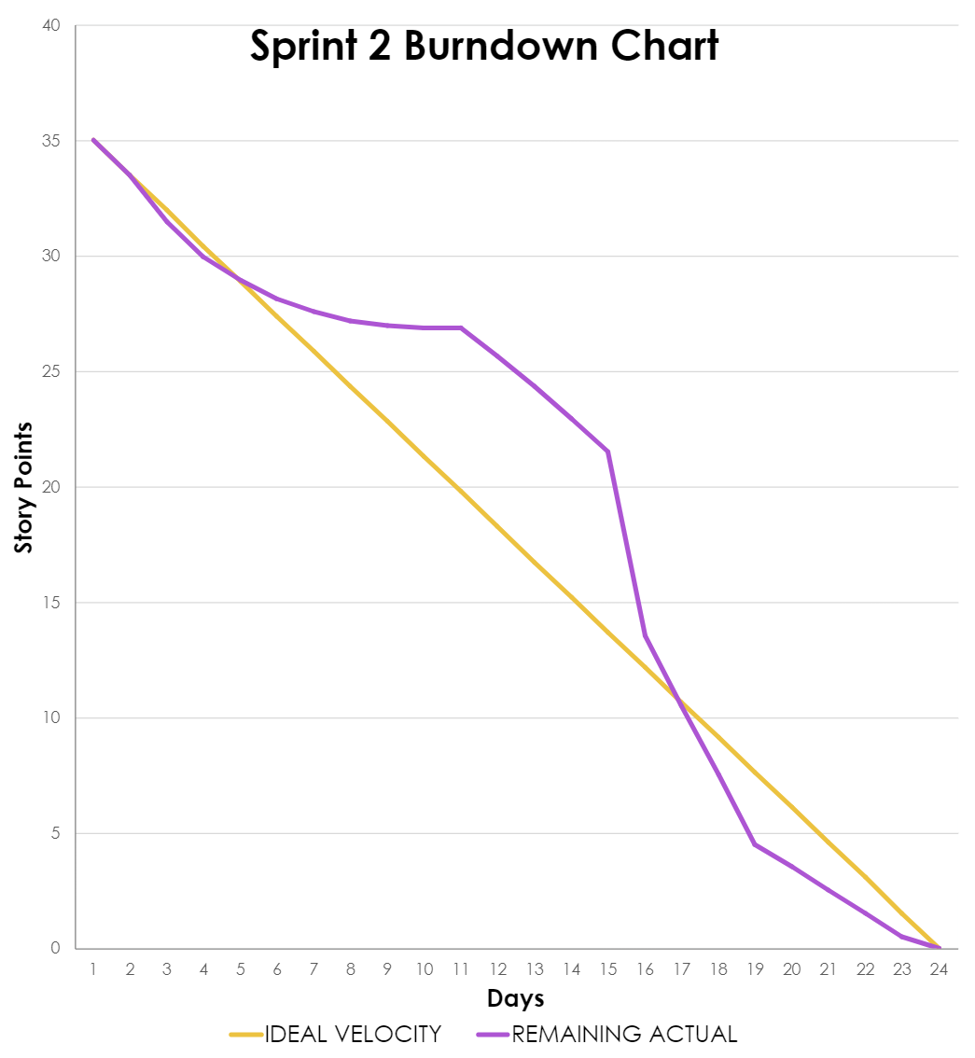
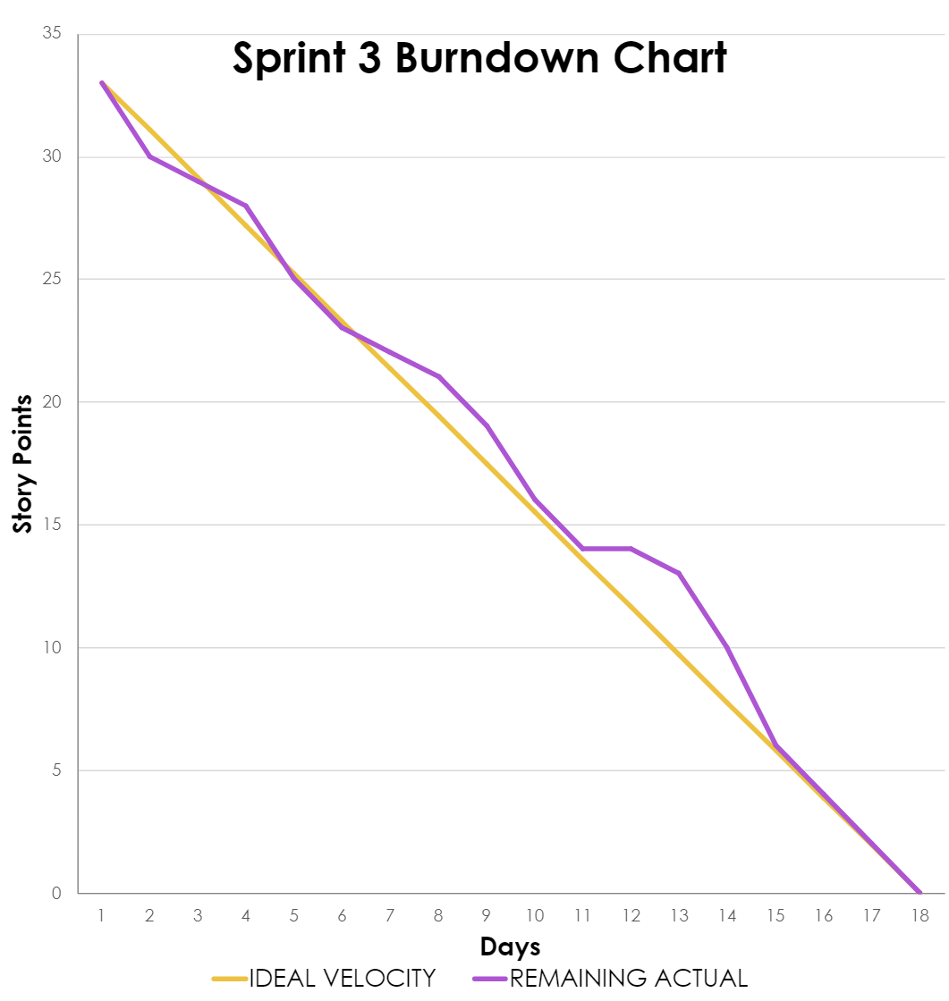
Burndown Chart

Slide 51
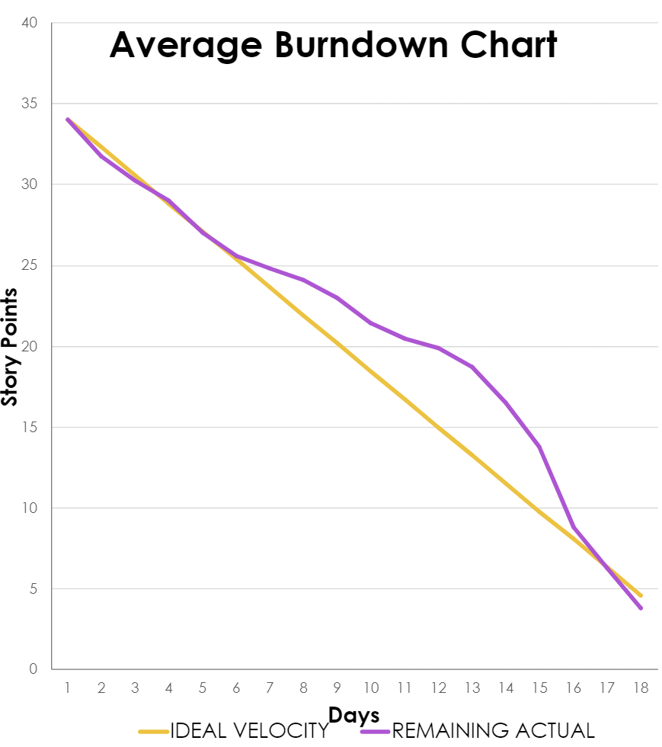
Burndown Chart

Slide 52
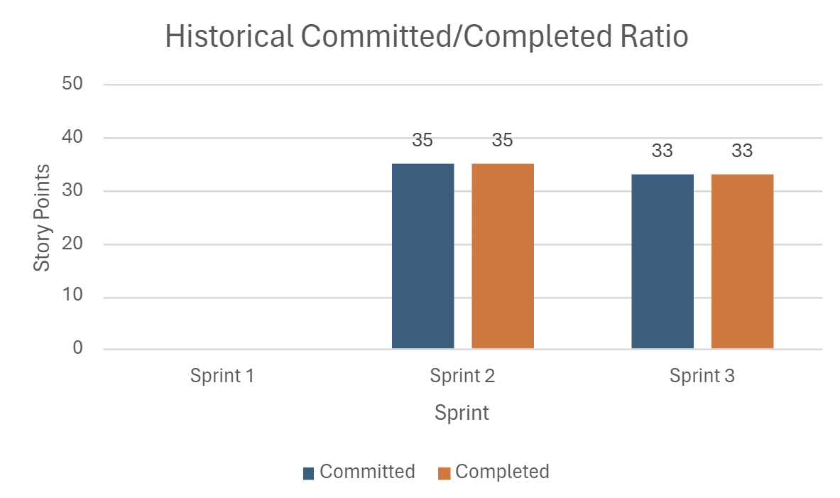
Completed / Committed Ratio
Avg
34 pts
100%
Sprint 3 Story Points: 33

Slide 53
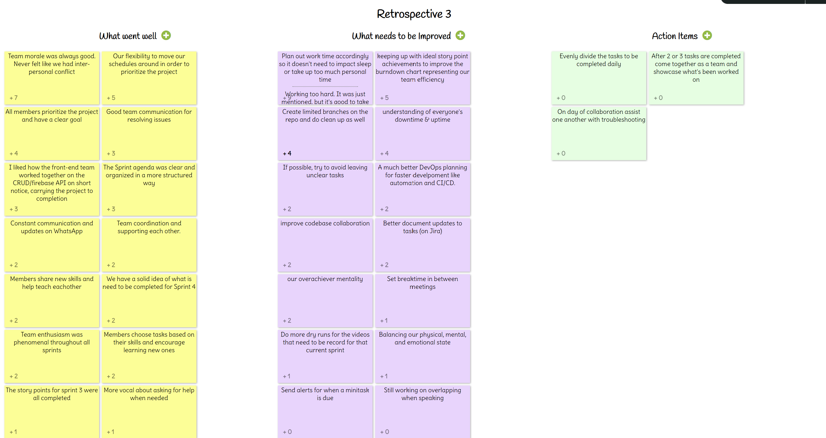
Retrospective:

Slide 54
Retrospective:
What Went
Well
What needs to be Improved
Action
Items
Team morale was good; no interpersonal conflict
Flexibility to move our schedules around to prioritize the project
Good team communication for resolving issues
Sprint Agenda was clear, organized, and structured
Plan out work time so it doesn't impact sleep or personal life
Keeping up with story points to improve burndown chart
Create limited branches on the repository and maintain it
Evenly distribute the tasks to be completed daily
After 2 or 3 tasks are completed come together as a team and showcase what's been worked on
On day of collaboration assist one another with troubleshooting

Slide 55
Sprint 4 Workload:
Estimation | User Story ID | As a | I want | So that | Feature
2 | 8 | Patient | my x-ray results to be explained in simpler terms | I can better understand my diagnosis and health issue | Result Description
5 | 11 | Patient | to have access to all of my x-ray report history | I can track my chest health issues | Report History
5 | 12 | Doctor | to have access to all patient x-ray report histories | I can track patient chest health issues | Report History
5 | 14 | Patient | to be notified once there is a change to my reports (upload, review, notes, etc.) | I can be informed about any updates as soon as possible | Notification
5 | 15 | Doctor | to be notified once there is a change to patient reports (upload, report, etc.) | I can be informed about any updates as soon as possible | Notification
Sprint 4 Story Points: 44

Slide 56
Sprint 4 Workload:
Estimation | User Story ID | As a | I want | So that | Feature
3 | 18 | Radiologist | to register and store my personal info (ID, name, D.O.B.) in my own account | I can access patient information and connect with patients and doctors privately | Profile
3 | 19 | Doctor | to register and store my personal info (ID, name, D.O.B.) in my own account | I can access patient information and connect with patient and radiologists privately | Profile
3 | 20 | Patient | to register and store my personal info (ID, name, D.O.B.) in my own account | I can access my medical information and connect with doctors privately | Profile
3 | 21 | Patient | to login and logout of my own account | my medical information, records and reports are secure | Login/Logout
3 | 22 | Doctor | to login and logout of my own account | Patient medical information, records and reports are secure | Login/Logout
Sprint 4 Story Points: 44

Slide 57
Sprint 4 Workload:
Estimation | User Story ID | As a | I want | So that | Feature
3 | 23 | Patient | to login using my e-mail address | I can access my medical information, records and reports | Login/Logout
3 | 24 | Doctor | to login using my medical professional ID number | I can access patient medical information, records and reports | Login/Logout
1 | 25 | Patient | update my personal information such as my name, address, phone number etc. | the portal has up-to-date information in the event I need to be reached urgently | Profile
Sprint 4 Story Points: 44

Slide 58
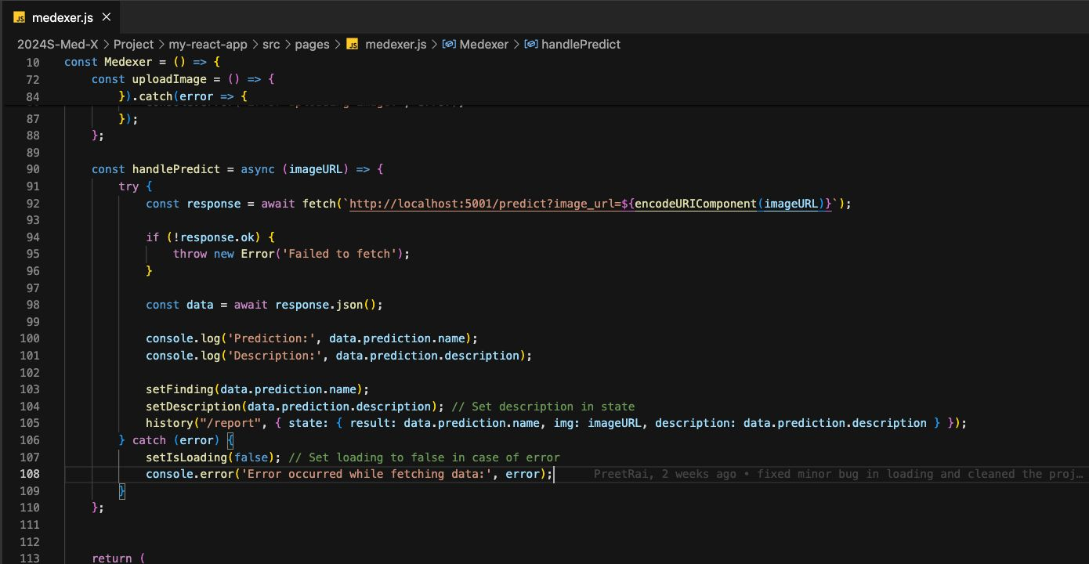
Code Snippet:

Slide 59
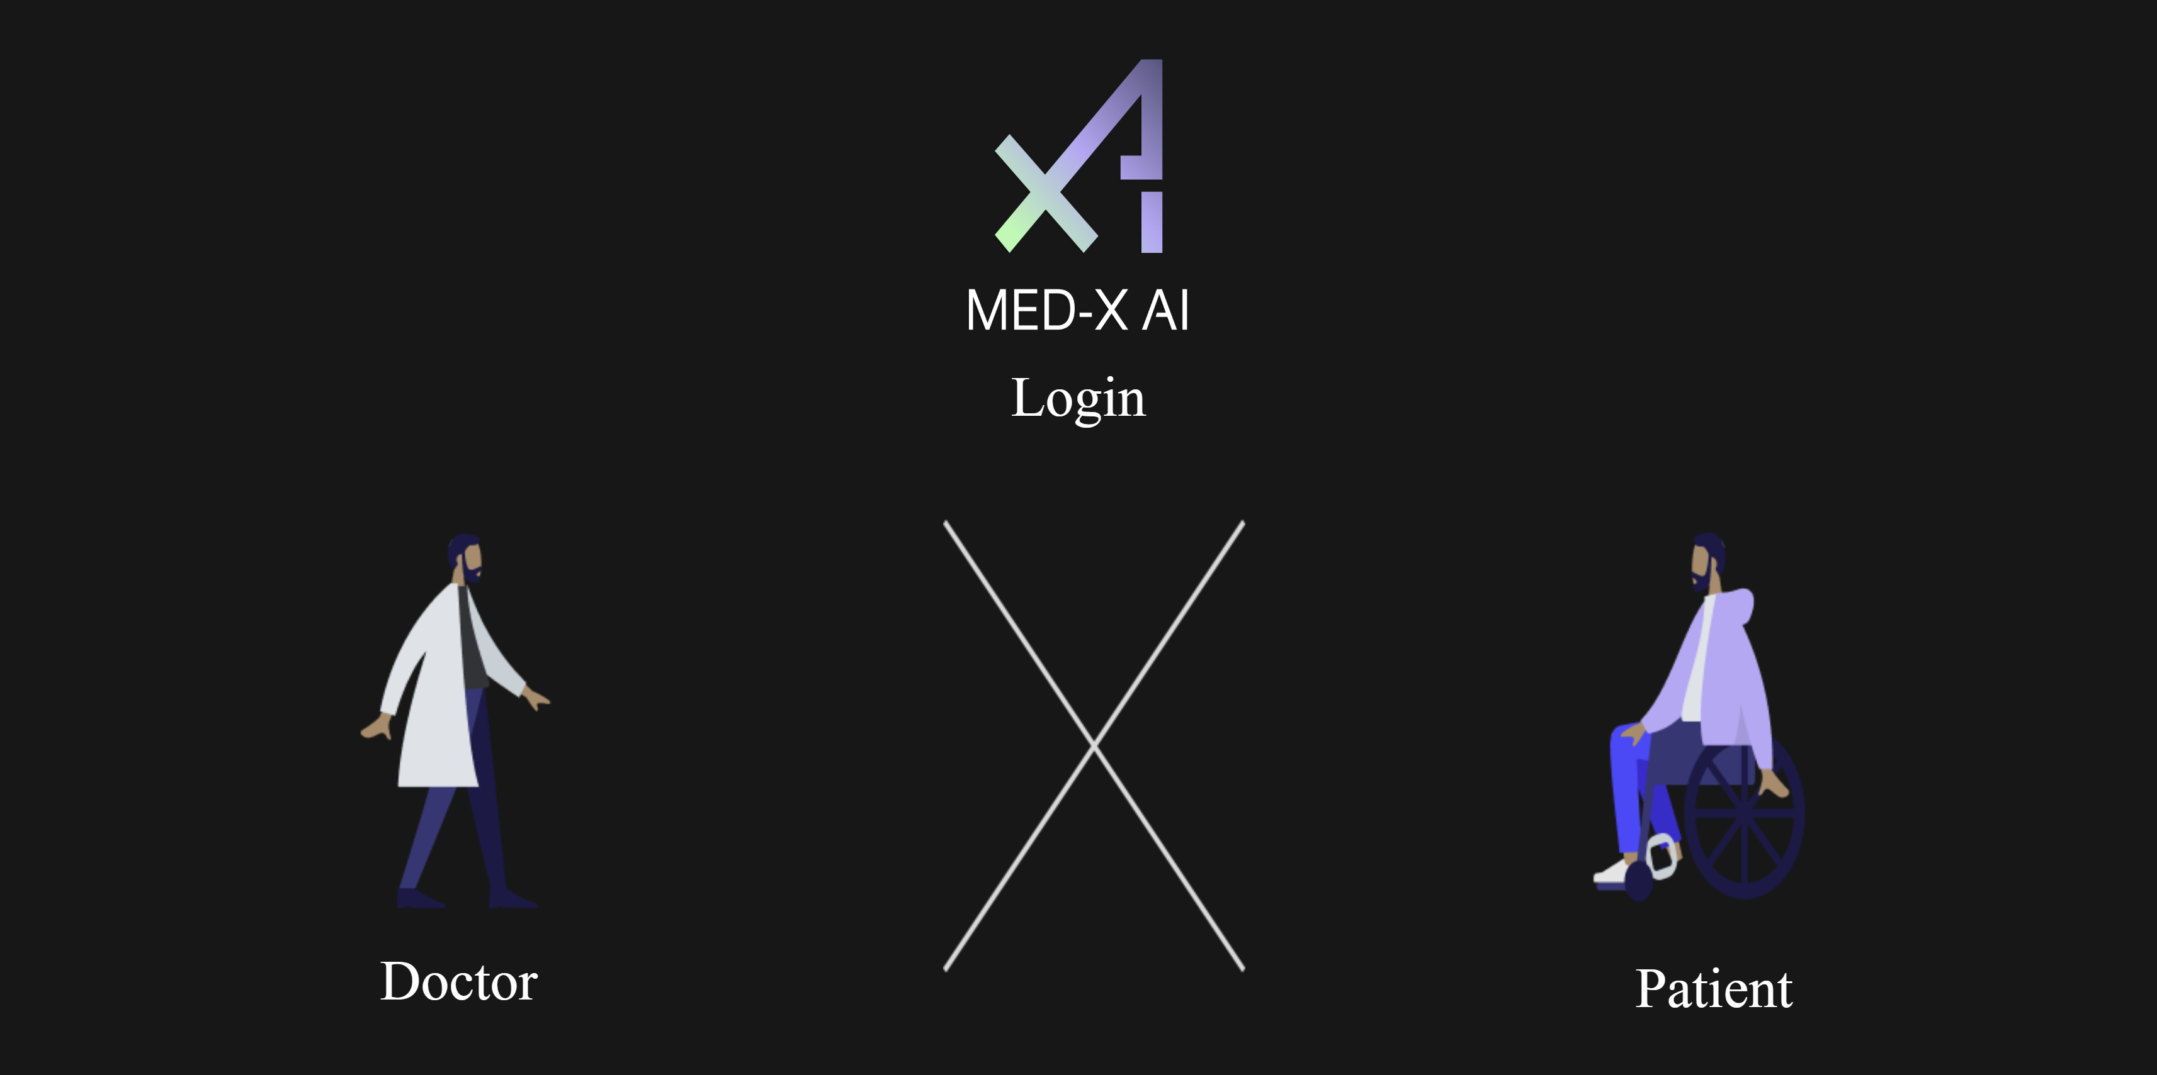
Application Screenshots:

Slide 60
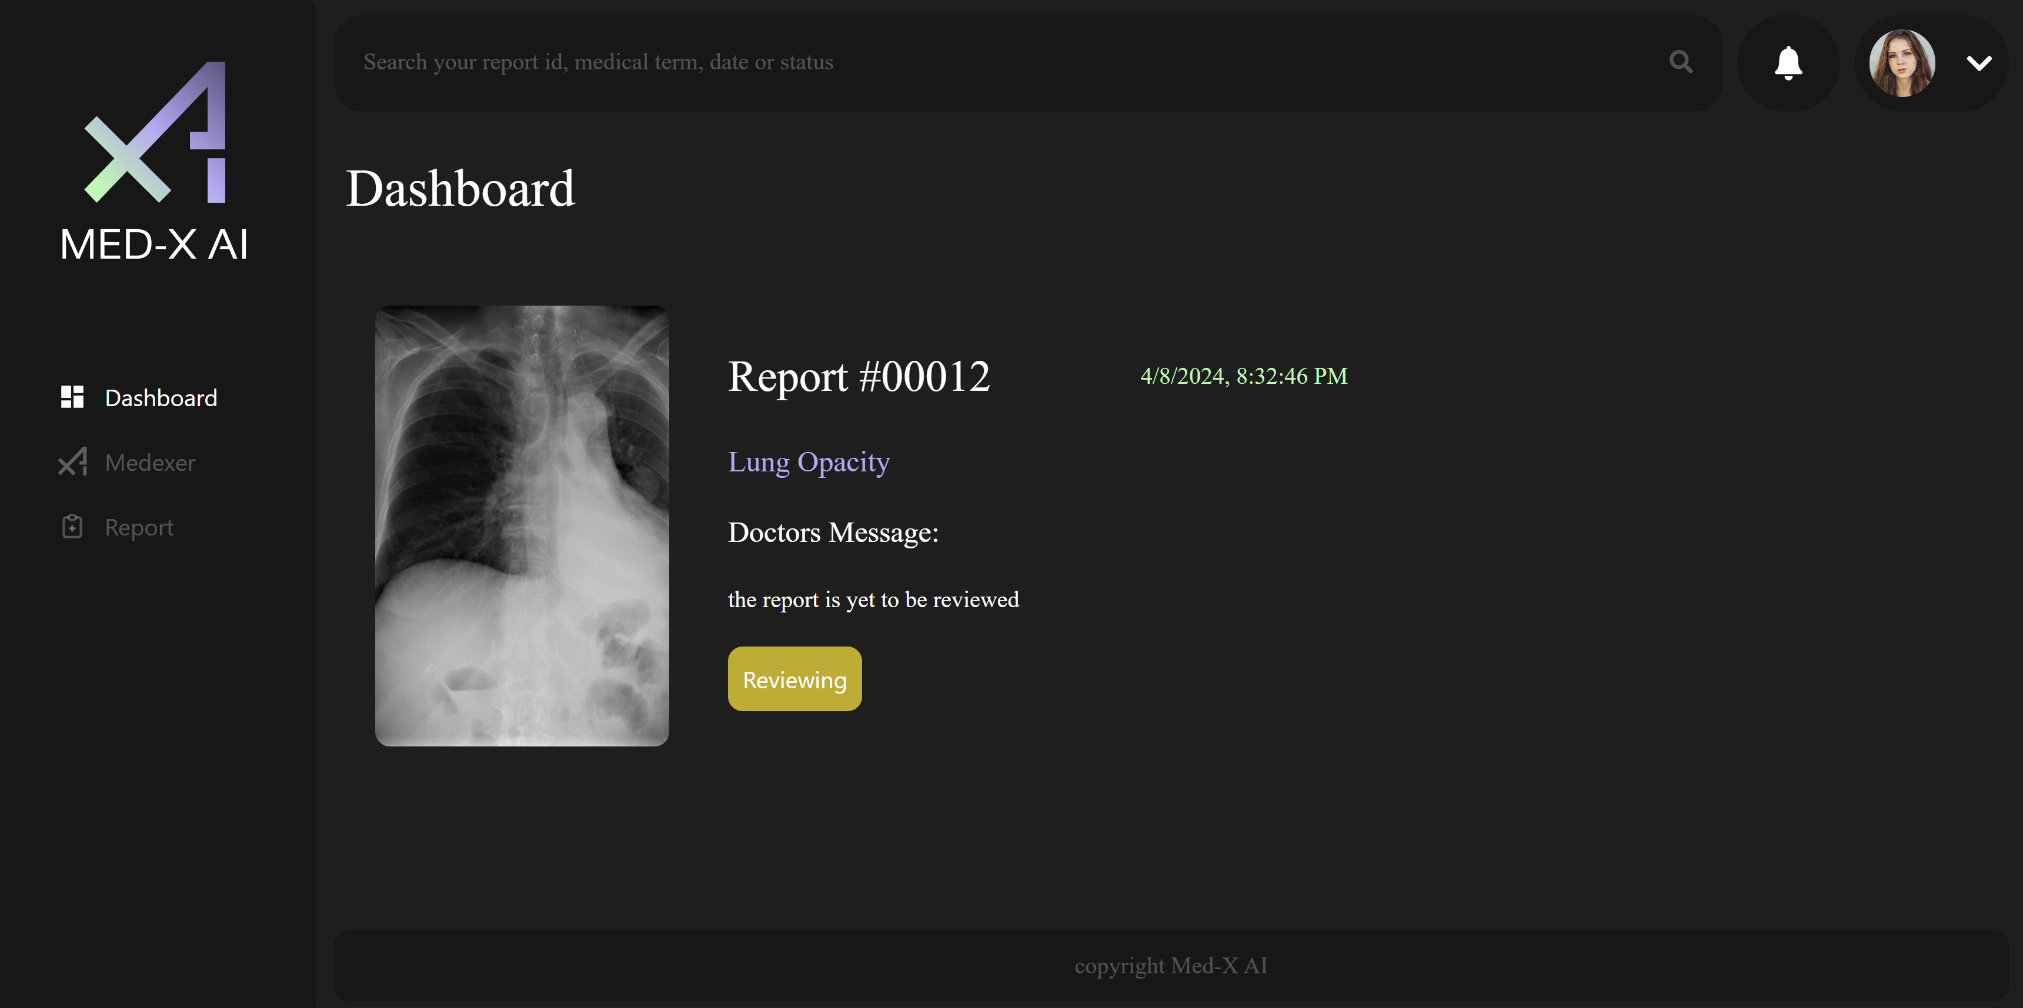
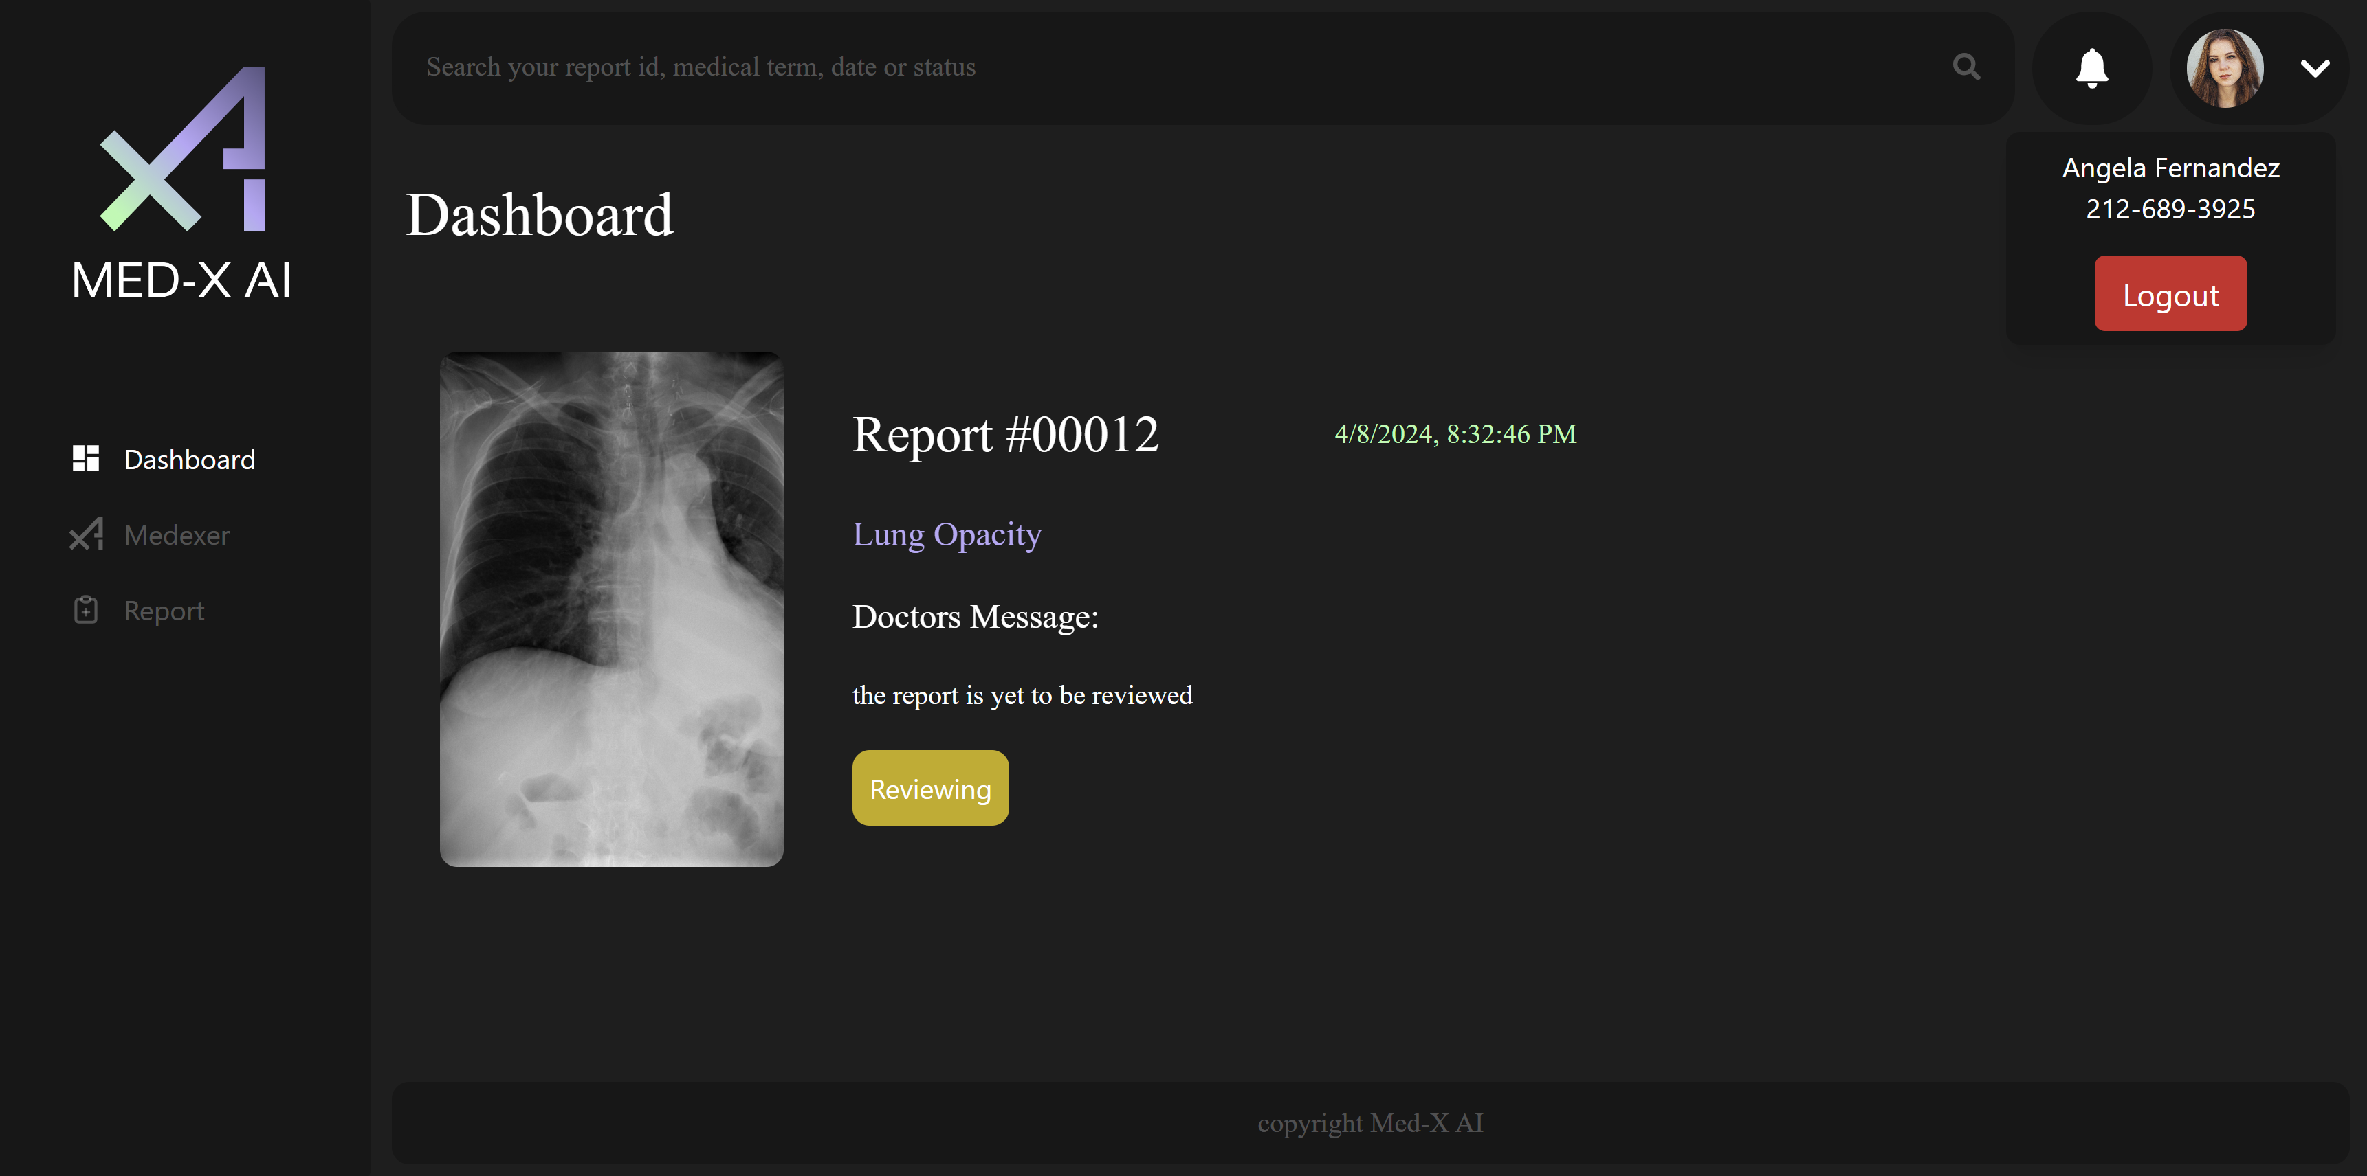
Application Screenshots:

Slide 61
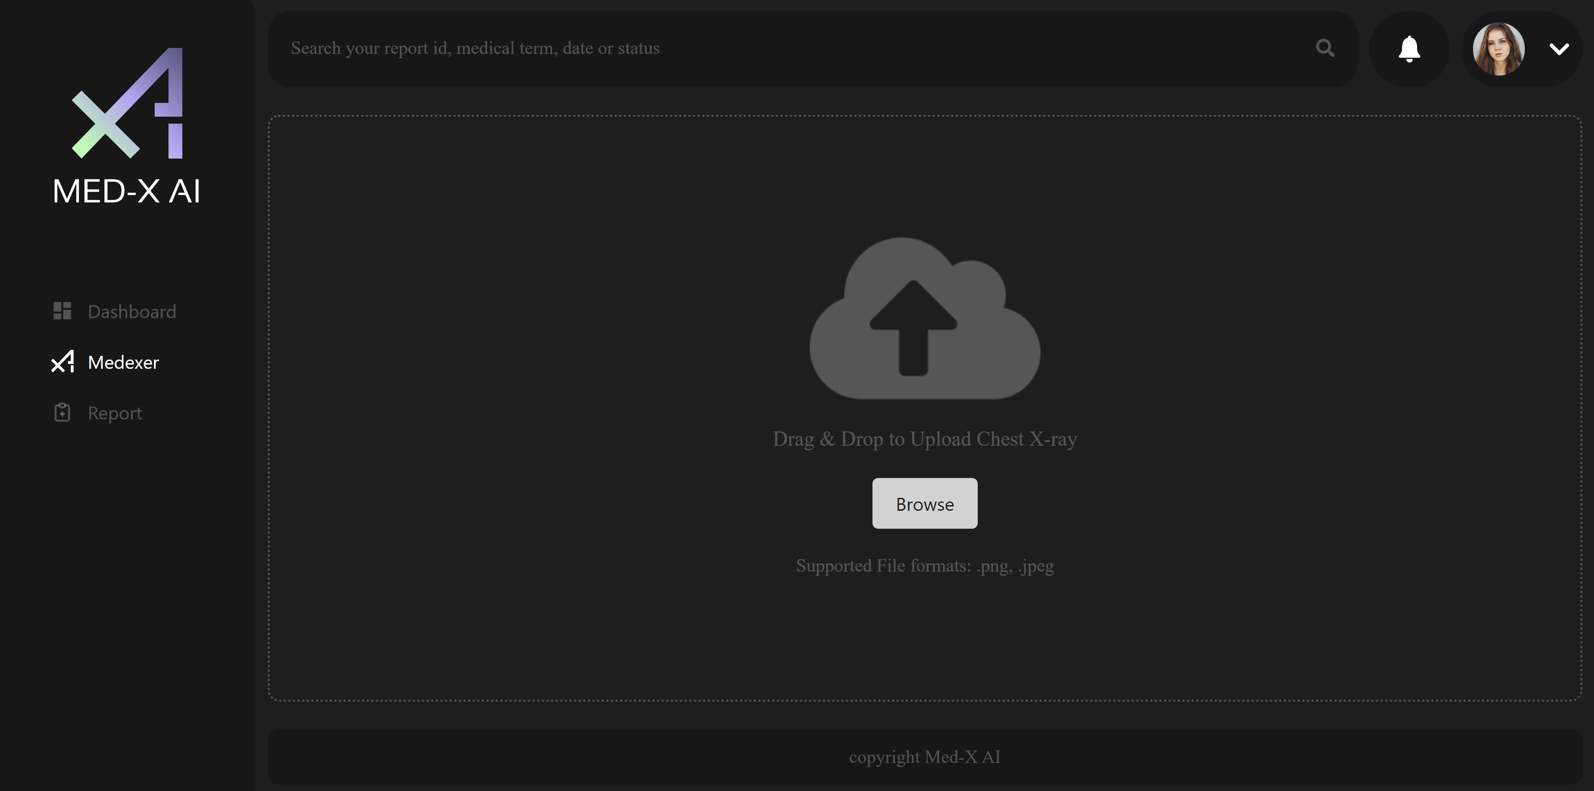
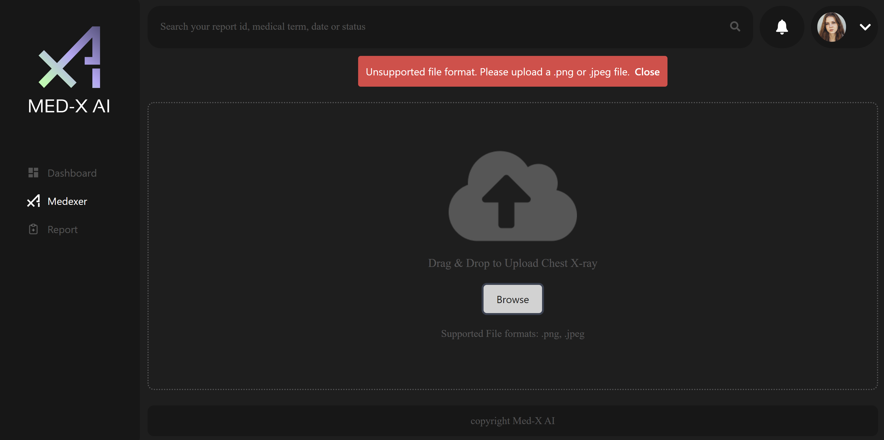
Application Screenshots:

Slide 62
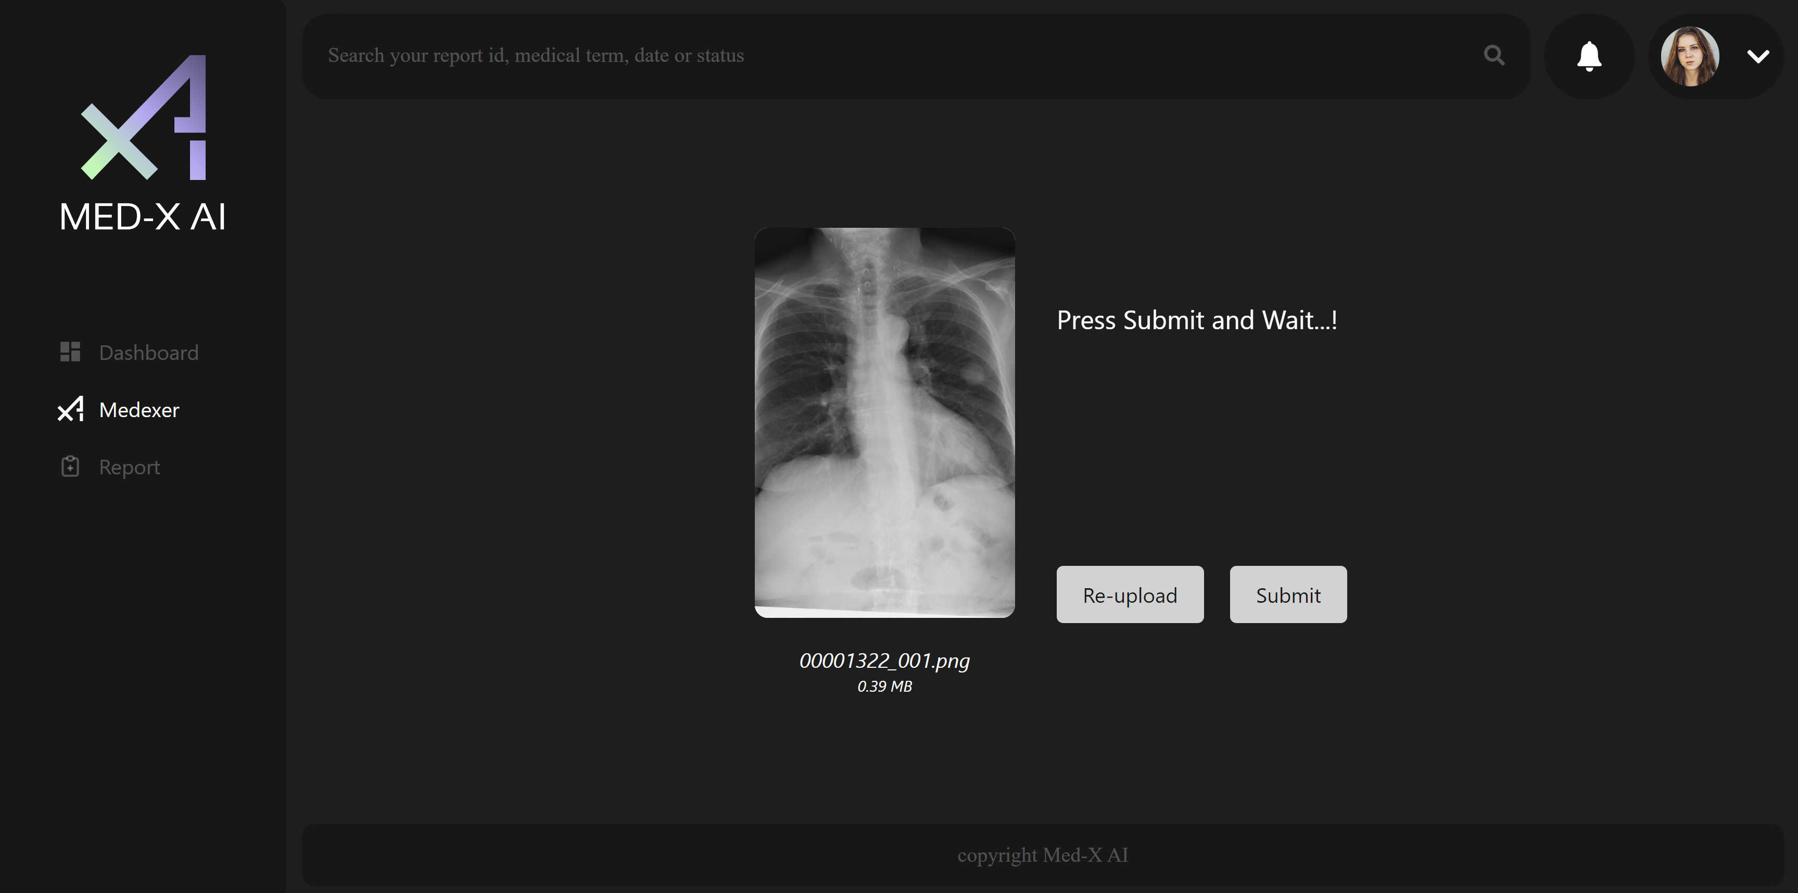
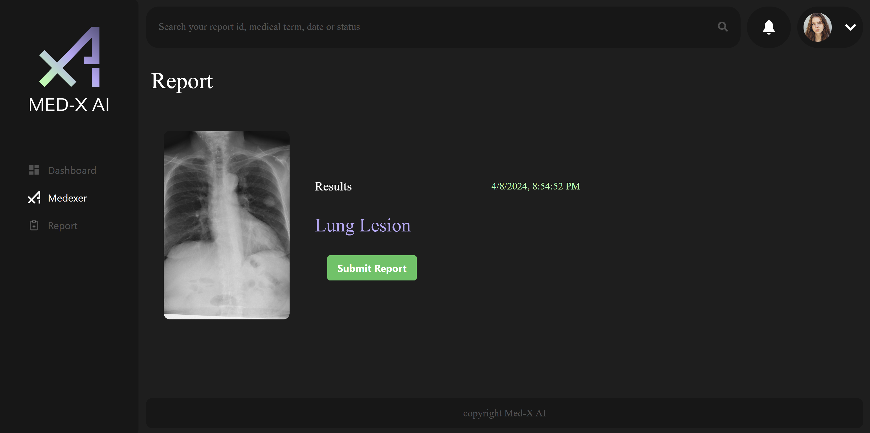
Application Screenshots:

Slide 63
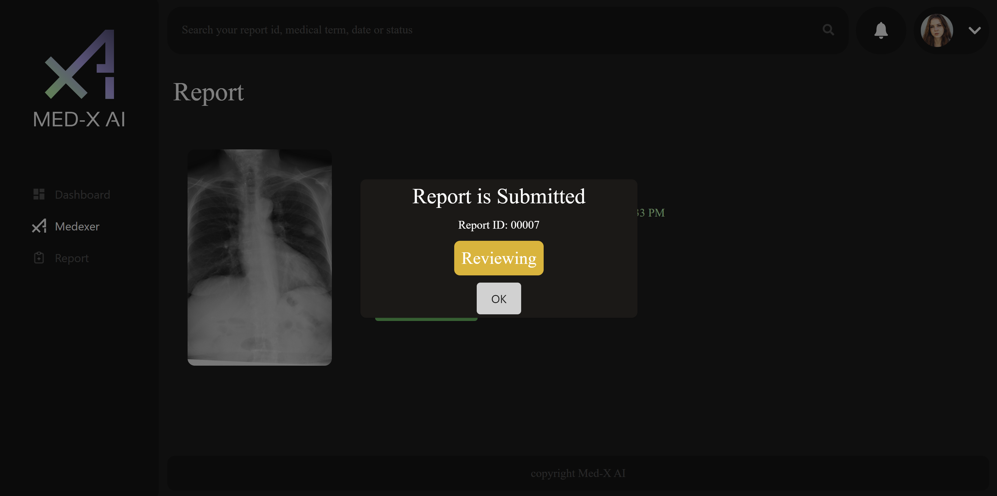
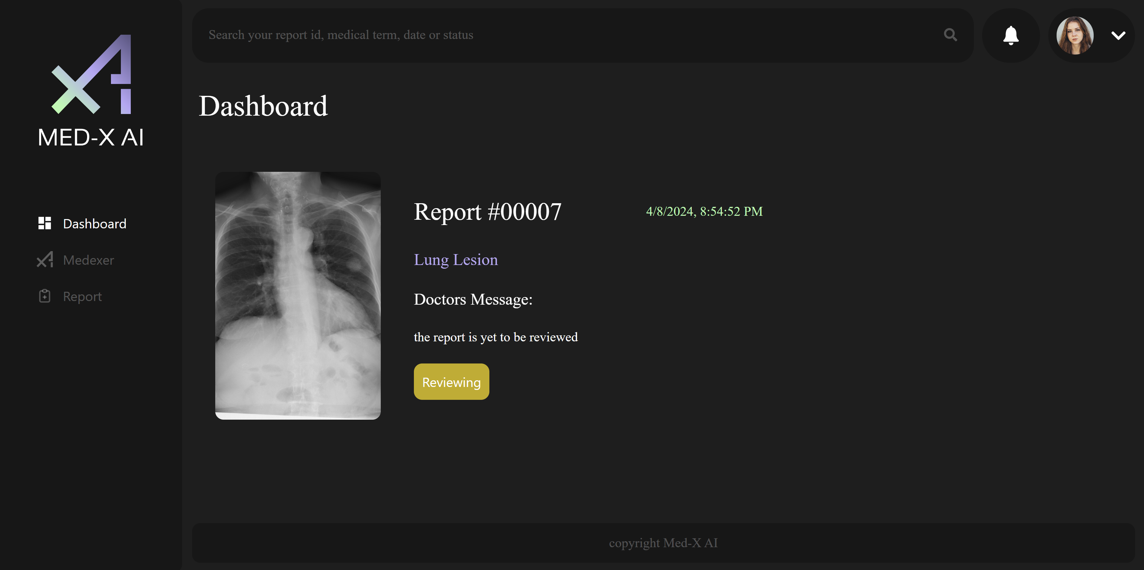
Application Screenshots:

Slide 64
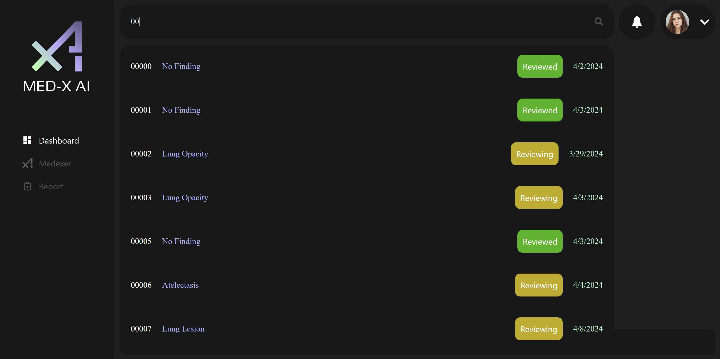
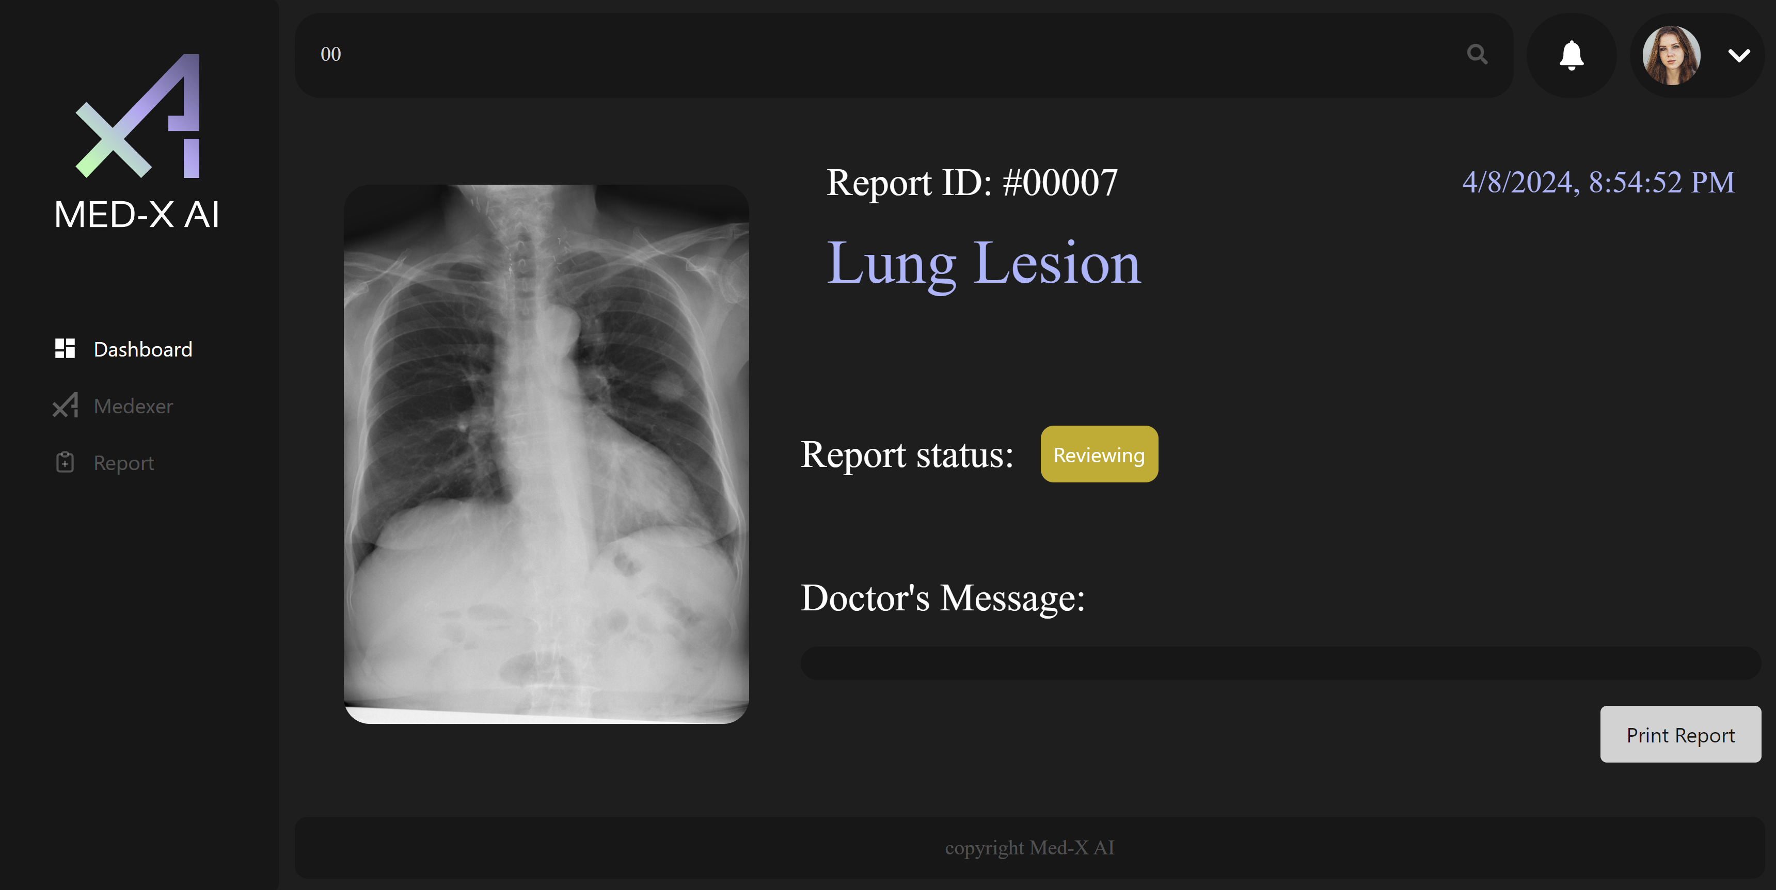
Application Screenshots:

Slide 65
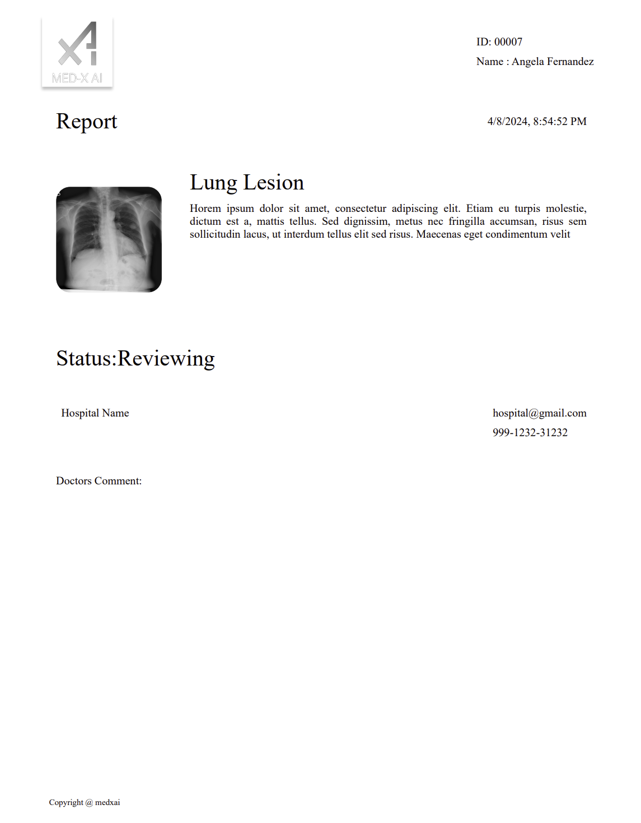
Application Screenshots:

Slide 66
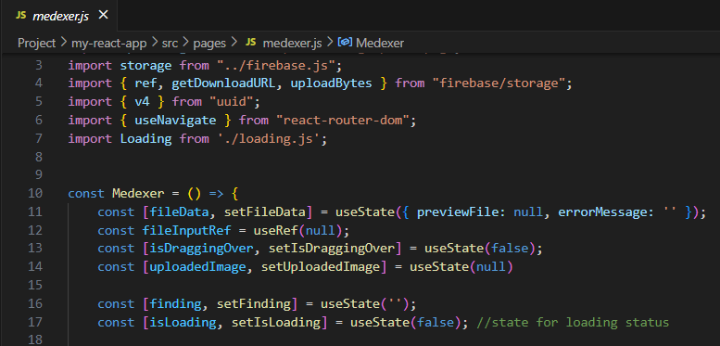
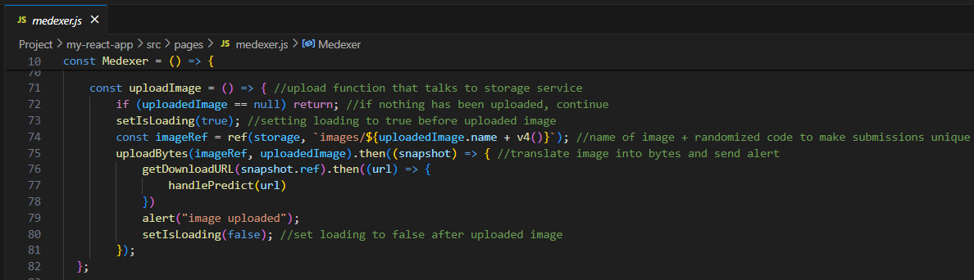
Firebase API:
Notes:
We chose Firebase over MongoDB because Firebase cloud services come with google APIs which allow our team to use our urls of our images with vast array of cloud services provided by Google and third-party providers.
In Medxer page, we import the apis to access Firebase's storage services like ref, getDownloadURL, and UploadBytes.
We use the first to create a reference from the storage service, the second to copy the google-generated api embedded inside the uploaded images urls for later use, and finally uploadBytes generates the url of the uploaded image by converting the JavaScript object into bytes.

Slide 67
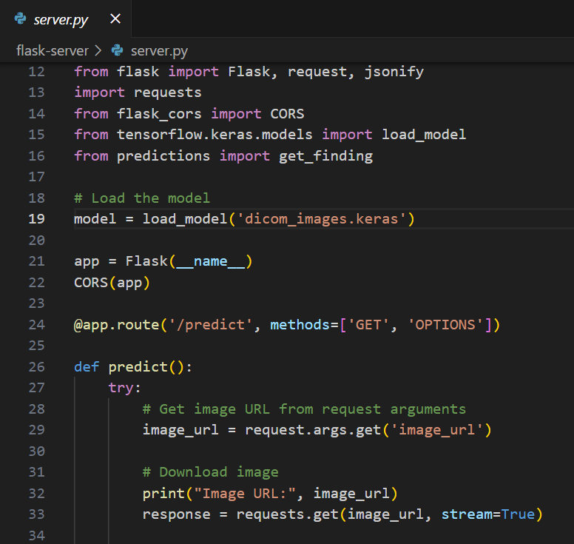
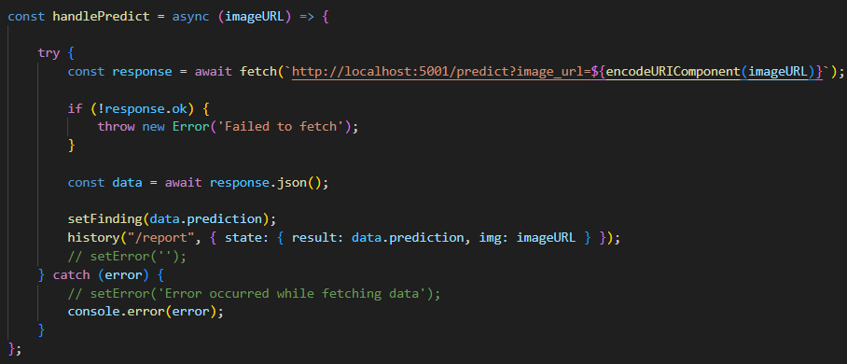
Flask/Cors:
Notes:
Advantages to using Flask:
Continuous Python runtime environment and library similar to NodeJS
The CORS class allows for direct exposure of the back-end service without using middleware like proxy.
Ease of use and customization of back-end services

Slide 68
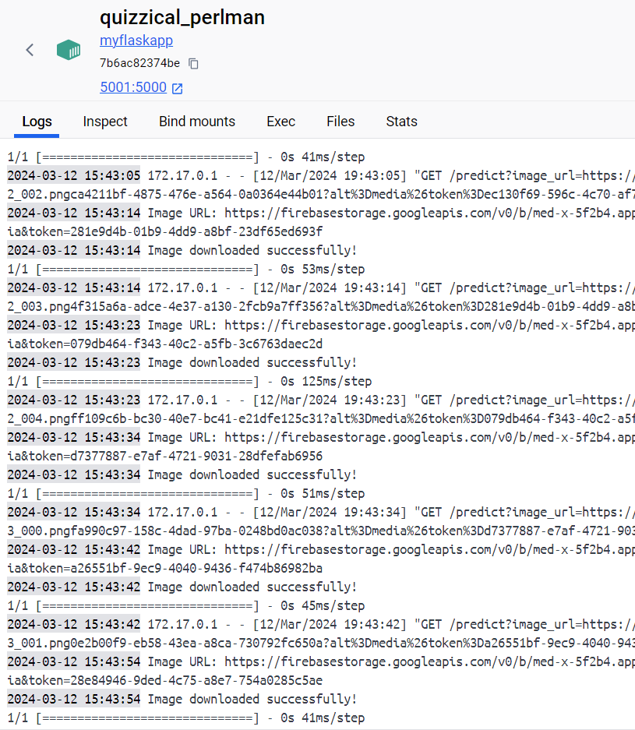
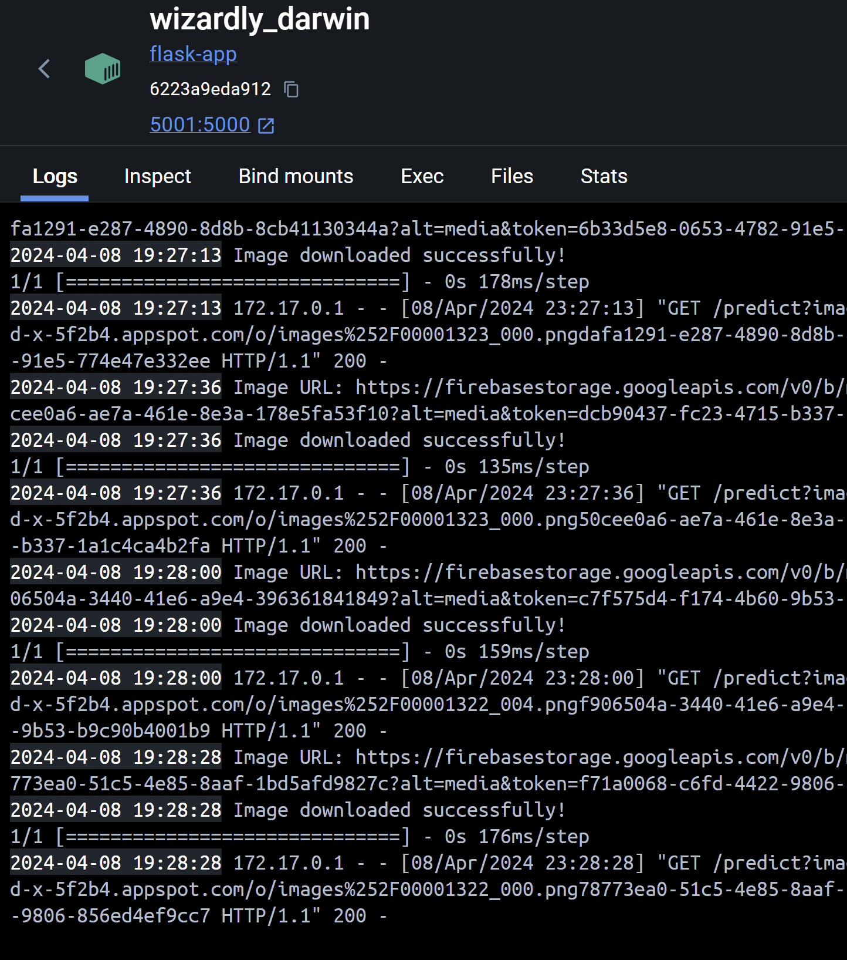
Docker for CI/CD:
SPRINT 2
SPRINT 3
Notes:
Dockerizing the back-end allowed our team to receive consistent test results on our machines because the app's dependencies are executed in a virtual environment based on a Linux kernel that encapsulates the Flask runtime environment for Python executables.
As you can see from the container's terminal view, the average response time for the back-end API response is twice as fast, the average speed is 59 ms, a considerable drop from 121 ms experienced in the Jupyter notebook in which we tested the neural network.

Slide 69
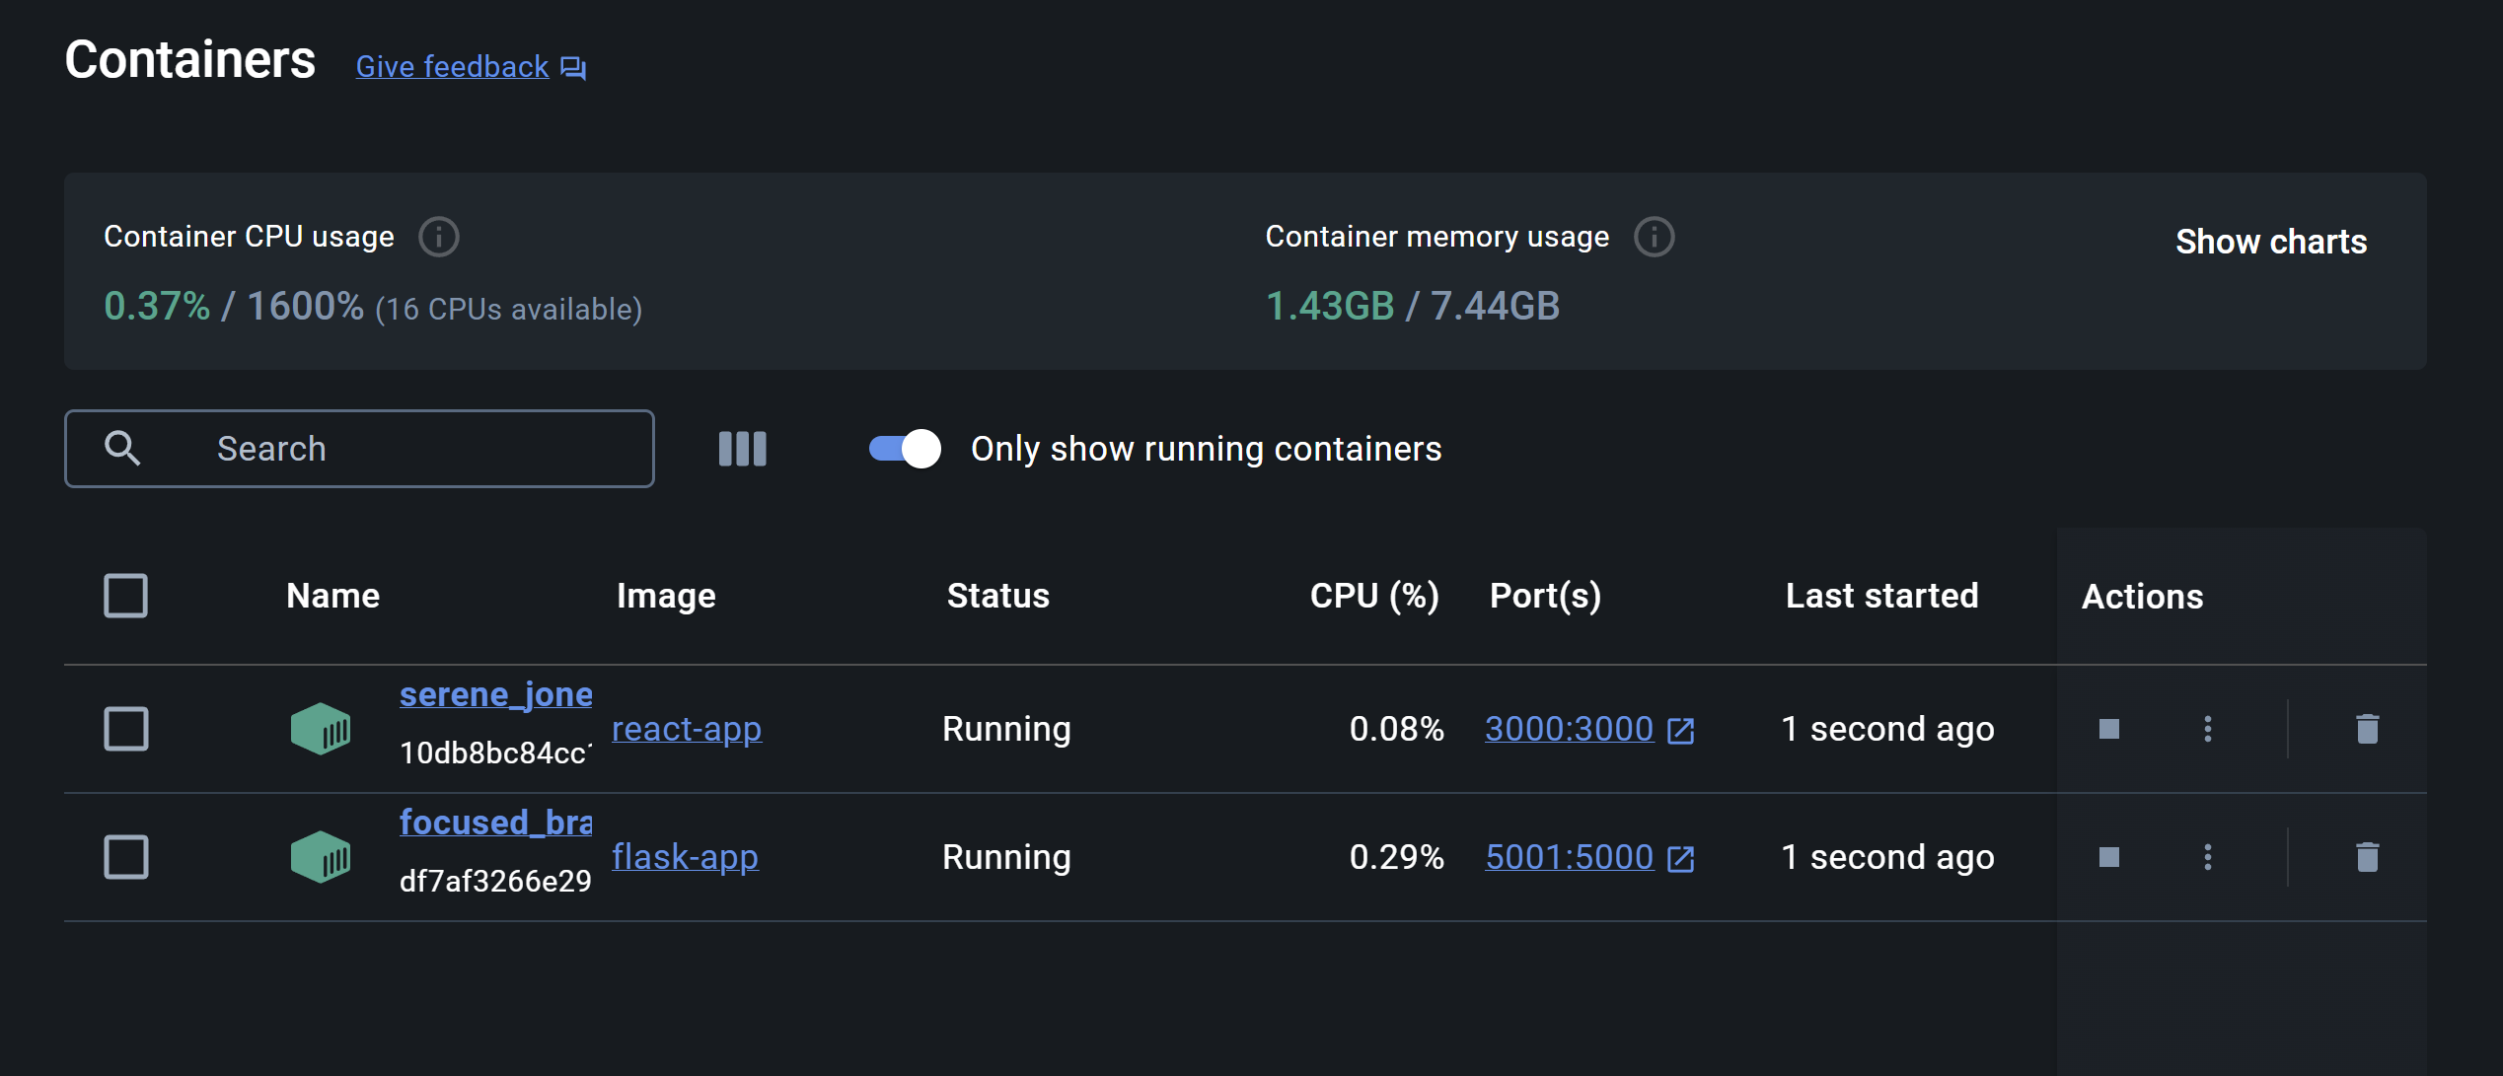
Docker:
Notes:
Perhaps, the greatest benefit of dockerizing both the front-end and back-end is booting into the application in seconds after clicking on the containers' ports instead of executing docker commands in our terminals.

Slide 70

Live Application Demo:

Slide 71
Next Steps:
Notify the user when the status of the report is updated
Create multiple user sessions
Provide a friendly definition of the medical term
Create a registration page

Slide 72
Wikipage Link
https://github.com/htmw/2024S-Med-X/wiki

